Slide 1
Biomedical Applications of
Atomic Force Microscopy
  Etienne DAGUE
  LAAS-CNRS
  Micro Nano Bio Technologies Department
Notes:
Bonjour
Je m’appelle E Dague, je suis chercheur au LAAS. àToulouse dans l’équipe ELIA pù je développe mes activités de Technologie AFM …

Slide 2

LAAS-CNRS
Laboratory for Analysis and Architecture of Systems

Slide 3



Key facts & figures
  LAAS
    CNRS lab located in Toulouse, France
    Associated to the University of Toulouse
  Taskforce
    500 among which 300 researchers and engineers
    60 PhD students graduating/year
  Budget
    3 M€/month (including salaries)
    Main funding sources: 21% National, 14% Europe and 12% Industrial partnership
  5 (ERC & European contracts)/year
  10 Patents/year – 4 Licenses/year
  1.5 Publications/day (50% in the first quartile)
Toulouse

Slide 4
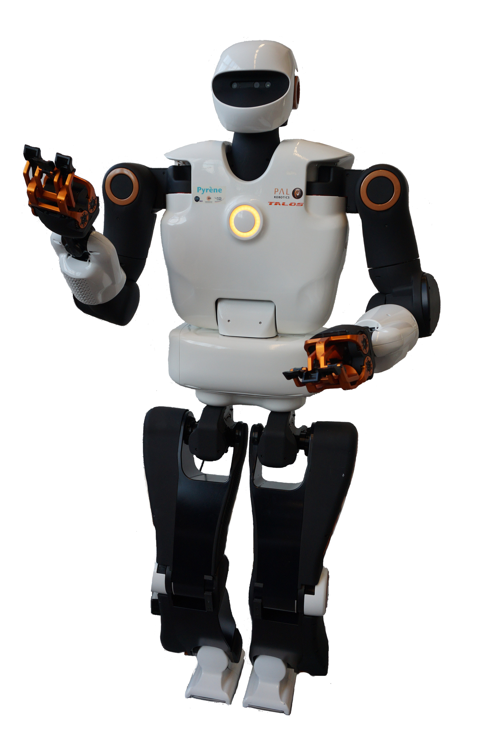


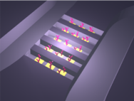
4 major research fields
COMPUTER SCIENCE | AUTOMATIC CONTROL | ROBOTICS | MICRO & NANOSYSTEMS

Slide 5
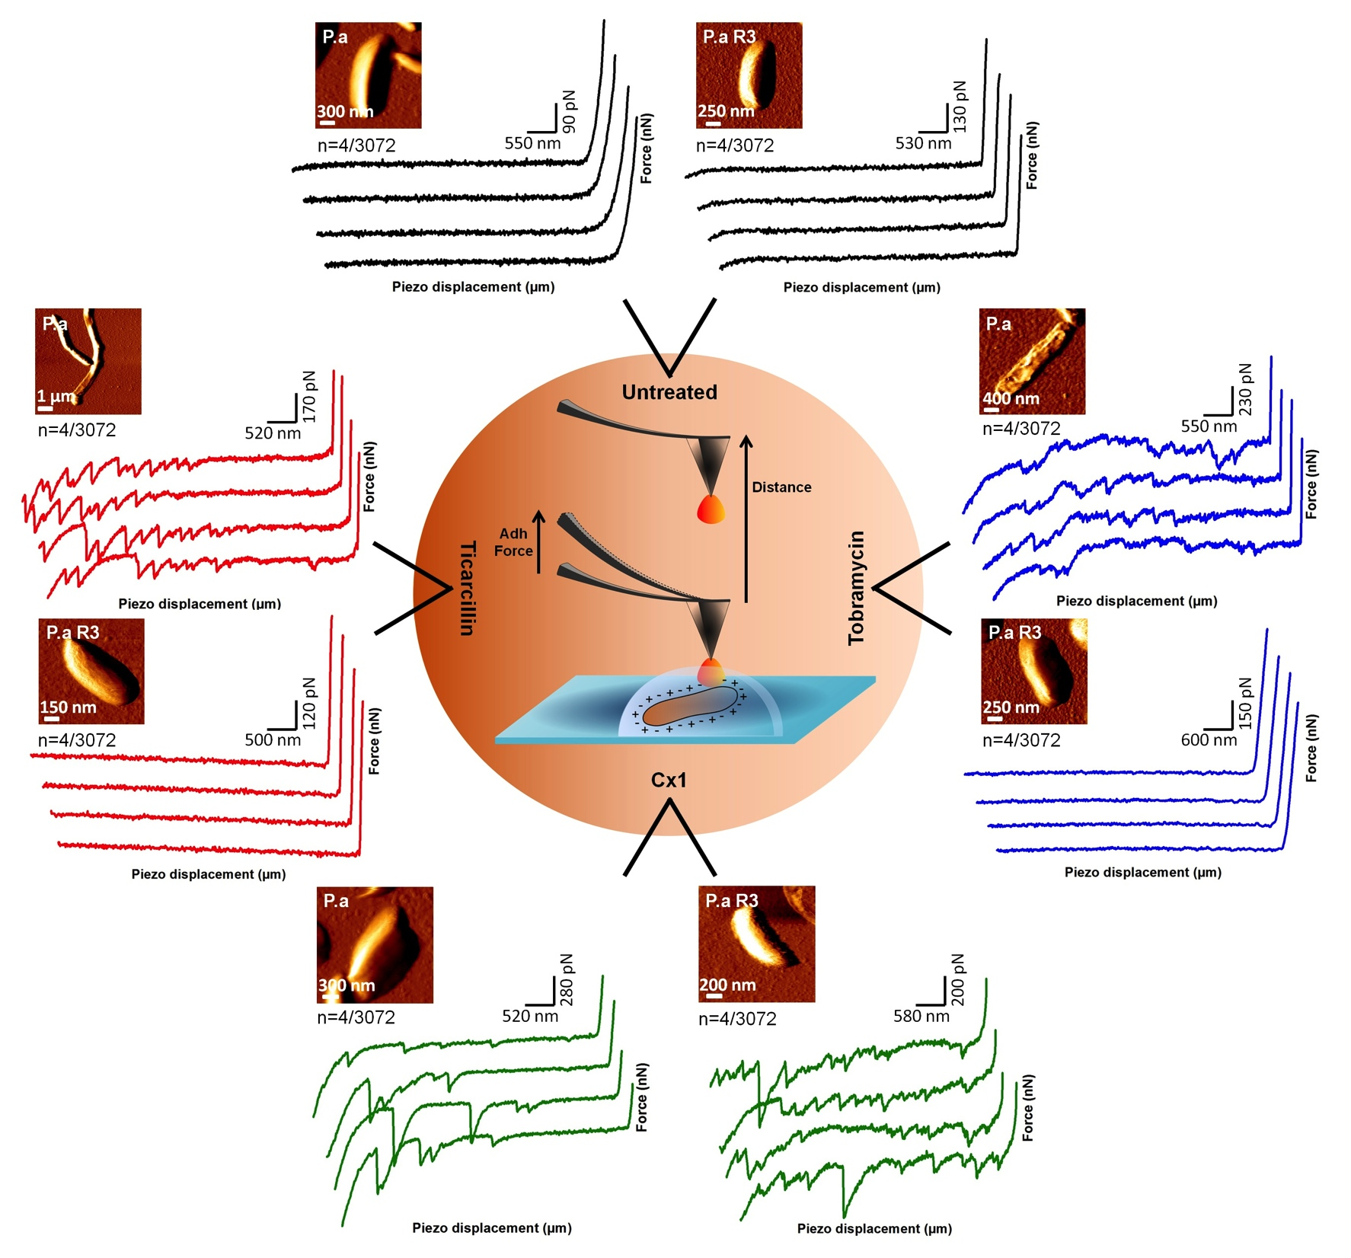
Scientific approach
1. Technological development around Bio-AFM
2. Responding to an original biological problem
3. Deploy the technology to other applications, to other biological systems
Develop:
Dendritip : Biofunctionalization of AFM tips
2 . Apply:
Measurement of membrane integrity, unfolding of surface molecules
Brevet et Sensors and actuators 2012.
3. Generalize
Oligomerization of GPCRs at the surface of living cells
- J. Mol. Recogn. 2015,
- Communications in Biology, Under revision
Sci. Rep. 2012
The Cell Surface, Frontiers in Microbiology…
Notes:
EXEMPLE
r exemple, j’ai développé et breveté DENDRITIPS : c’une technologie de fonctionnalisation des pointes AFM par des molécules biologiques (des anticorps, par exemple).
Grâce à ces pointes fonctionnalisées je peux réaliser des expériences d’interaction moléculaire à l’échelle de la molécule unique, des réactions ligand-récepteur et des cartographies moléculaires à la surface de cellules vivantes.
En microbioloigie l’utilisation des DENDRITIPS fonctionnalisée par une lectine a permis d’étudier l’intégrité membranaire de bactéries sensibles et multirésistantes aux antibiotiques. Les résultats ont montré que seul les bactéries sensibles ont leur paroi endommagé par le traitement antibiotique et cela a permis de démontrer l’efficiacité d’un nouvel antibactérien potentiel (le CX1 sur les bactéries multirésistantes.
d’apporter une nouvelle compréhension de l’organisation du peptidoglycane des bactéries. Le peptidoglycane est une cible majeure des antibiotiques et en, comprendre sa structure est essentiel pour le développement de nouveaux antibiotiques.
Enfin les DENDRITIPS sont la base du projet graphics qui a pour but d’étudier l’oligomérisation des Récepteurs Couplés aux Protéines G à la surface de cellules de mammifère vivantes.
Dans ce projet, la dendritip est fonctionnalisée par un anticorps anti HA dirigé contre le Tag HA exprimé par les RCPGs. En analysant les courbes de retrait nous avons découvert des longueurs de rupture qui sont des multiples de la taille des monomères.

Slide 6
Pharmacology of G Protein-Coupled Receptors
GPCRs = target of 40% of drugs on the market
Poor knowledge of their interactions with ligands responsible for many side effects
Hypothesis: GPCRs oligomers could be responsible and new drug targets could be developed
Objective: to analyze the oligomerization state of these receptors on living cells.

Slide 7
Anti-HA Dendritip and oligomerization status of GPCRs
Principle: GPCR HA label
AT1 and ß2 adrenergic receptor
on the surface of living cells,
Development: anti-HA dendritip
HA Tag molecular recognition on GPCR and anti HA antibodies on the tip
Journal of Molecular Recognition 2015,

Slide 8
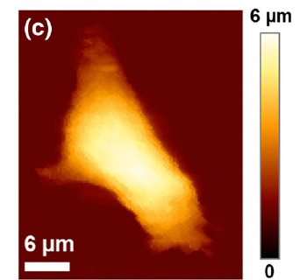
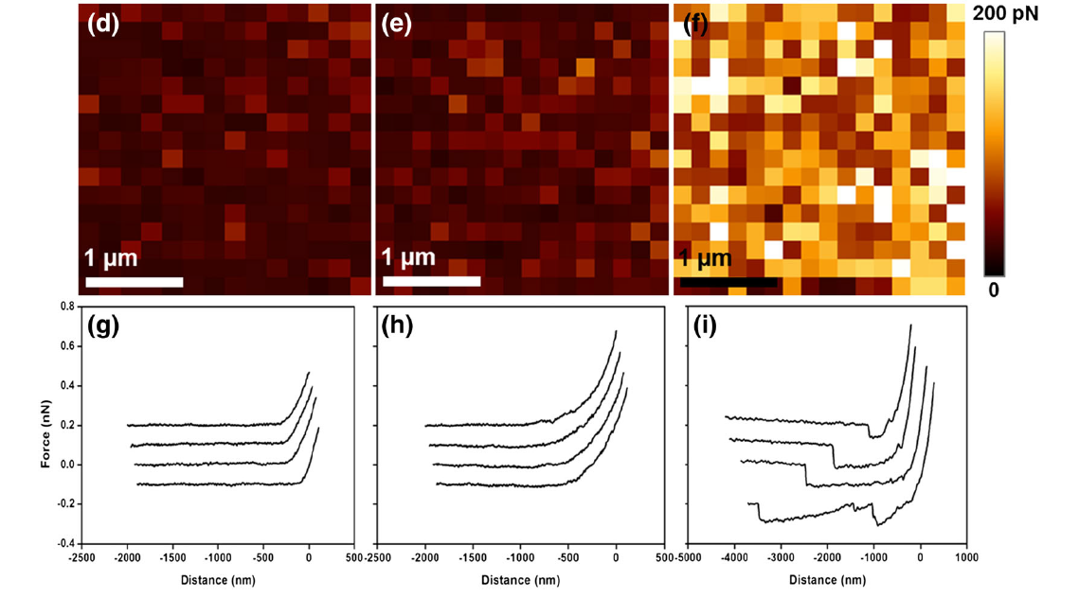
Dendritip anti HA and oligomeric status of GPCRs
Development: anti-HA dendritip
HA Tag molecular recognition on GPCR and anti HA antibodies on the tip
Application: unfolding GPCRs from living CHO cells
AT1 and ß2 adrenergic receptor
on the surface of living cells,
CHO HA-β2AR
CHO
CHO empty vector
C. Formosa et al. J. mol. Recogn. 2015
Collaborative work with C. Gales, Toulouse Hospital, INSERM

Slide 9
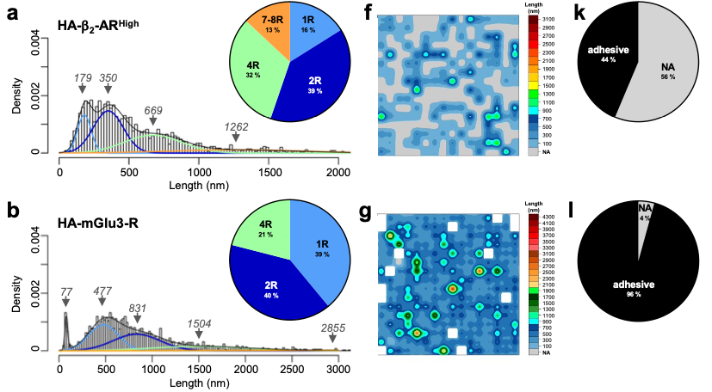
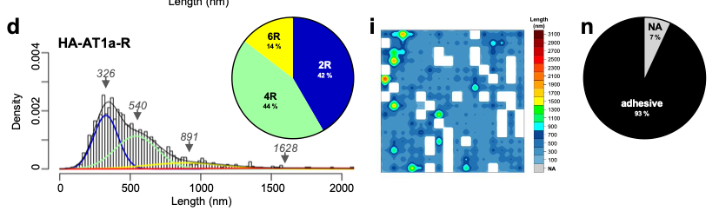
Can we unfold oligomers and decipher between them
B2AR : constitutive activity,
theoritic length of monomer 162 nm
Class A
MGlu3: No constitutive activity
Monomer theroticial length 345 nm
Class B
AT1: No Constitutive activity
monomer theoretical length 144 nm
Class A

Slide 10
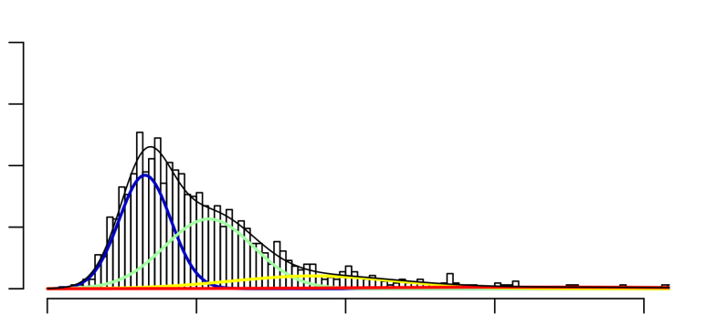
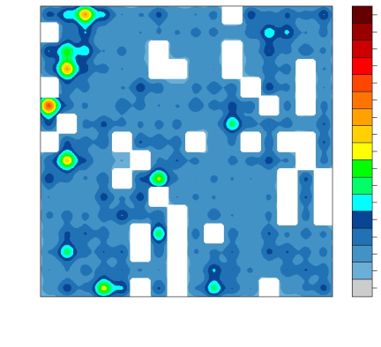
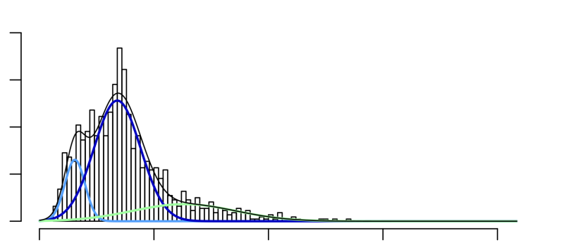
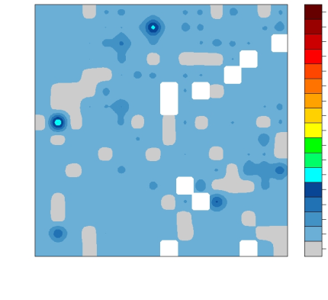
Oligomeric state of AT1 and angiotensin effect
Length
(nm)
HA-AT1a-R
3100
0.004
2900
2700
2500
326
2300
2100
1900
540
1700
0.002
1500
Density
1300
1100
891
900
700
1628
500
300
0
100
NA
0
500
1000
1500
2000
Length (nm)
Length
(nm)
HA-AT1a-R + AngII
3100
0.004
2900
338
2700
2500
2300
153
2100
1900
1700
0.002
1500
Density
1300
630
1100
900
700
500
300
0
100
NA
0
500
1000
1500
2000
Length (nm)
- Presence of dimers, mostly tetramers
- Induction of internalization of large oligomers by angiotensin II
En révision dans Communications in Biology
Notes:
Par exemple le récepteur à l’AT1, est organisé à la surface de cellules vivantes en dimères, tétra mère est hexamère et l’application d’un ligand naturel : l’angiotensine II induit - d’une part l’internalisation des récepteurs, puisque 35% des courbes deviennent non adhésives
- d’autre part à la disparition des grands oligomères qui semblent donc être les cibles du ligand

Slide 11
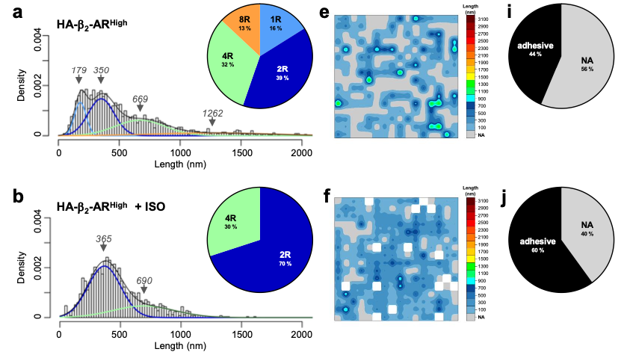
Oligomeric state of B2AR and agonist effect
- Presence of dimers, mostly tetramers
- More complex effect due to constitutive internalization activity

Slide 12
Global view of different ligands effect

Slide 13
Technology: directed immobilization of microorganisms
E. coli
Micro contact printing of anti-adhesive molecules, Languir 2009
P. aeruginosa
Polycation deposition after surface structuring by nanoxerography, ACS AMI 2015
S. cerevisiae ; C. albicans
- Microstructuring of a PDMS patch,
- Optimization by coupling with convective capillary deposition, Nat. Protoc 2015
Notes:
En effet, au début de ma carrière, je mes sui interessé à l’immo

Slide 14
Question: Microbial adhesion here model microorganism = Candida albicans
Some 2% hyperadhesive cells
Adhesive nanodomains, amyloid aggregation
Adhesion maps
- Nanomedicine, Nanotechnology Biology and Medicine 2015
- Antimicrobial Agents and Chemotheray 2015
Identification of adhesin nanodomains and
heterogeneity of the cell population

Slide 15
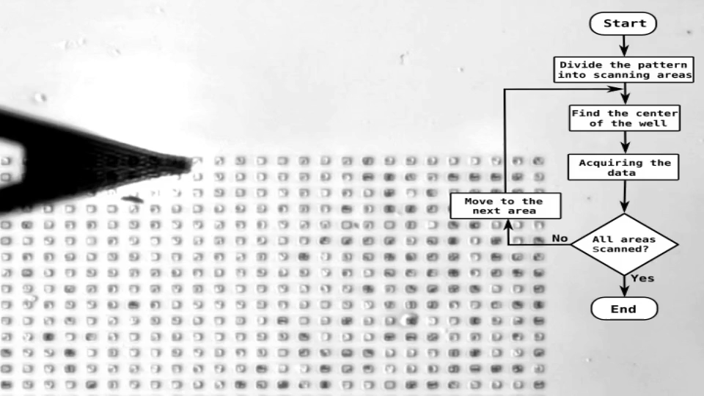
Development of a method to automate AFM measurements
Giving access to the heterogeneity of a cell population
Change of paradigm
  From thousands of curves per cell
  From a few curves on hundreds of cells
Combine directed immobilization and programming
Proa et al., Nanoscale Horizons 2020
Severac et al., JOVE 2021

Slide 16
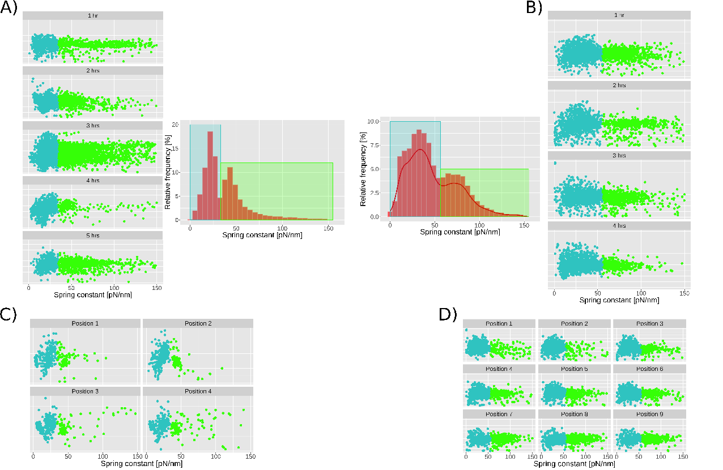
Subpopulations and effect of caspofungin
n = 957 cells
- 2 sub population based on spring constant in native cultures
- Decrease of spring constant in caspofungin treated cells
- no link with the time nor with the tip position
Native cells
n = 575 cells
Anti Fungal treatment
TIME
POSITION
Proa et al., Nanoscale Horizons 2020

Slide 17
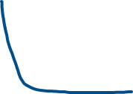

Machine learning toward mechanome
85% efficient supervised machine learning by combining 3 markers
  maximum adhesion,
  rigidity and
  Work of adhesion
Introduction of the notion of mechanome by Wang et al. Nanoletters 2021
Ec: Elasticity, σ: prestress 2 markers calculated on approach curve.
Their combination allows to better discriminate more or less invasive cell lines
 | Treated cells | Non treated cells | Total
Classified as Treated | 540 | 187 | 727
Classified as Native | 35 | 770 | 805
Total | 575 | 957 | 1532
Correct classification rate |  |  | 85.5 %
F = Fs + Fc = 4/3 E_{c} R^{0.5} d^{1.5} + 2 π² R d σ cos[tan⁻¹ (2 R / d)]

Slide 18
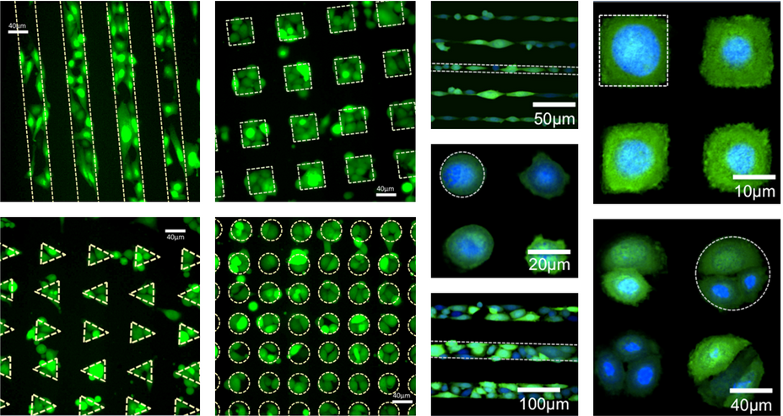
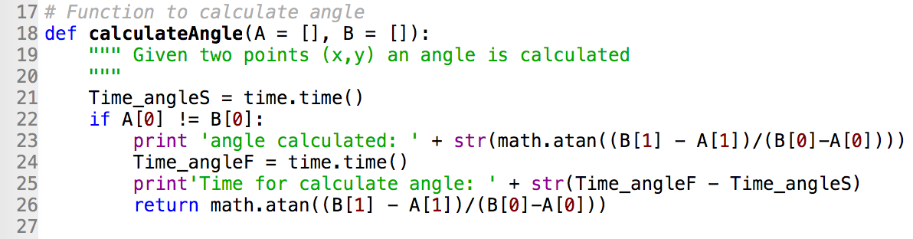
Adaptation to mammalian cells
Creation of eukaryotic cell chips : BioSoft: LAAS-Innopsys
  Microfabrication of molds Clean room LAAS
  Automated Micro Contact Printing of fibronectin Innostamp 40
  Cell culture
  PF cell culture LAAS
Python script driving the AFM from cell to cell
  find the coordinates of the 1st cell
  move from cell to cell
  correct step motor errors
  record the force curves on each cell
Notes:
Objectif de communication = montrer les disciplines nécessaires à la réalisation du projet

Slide 19
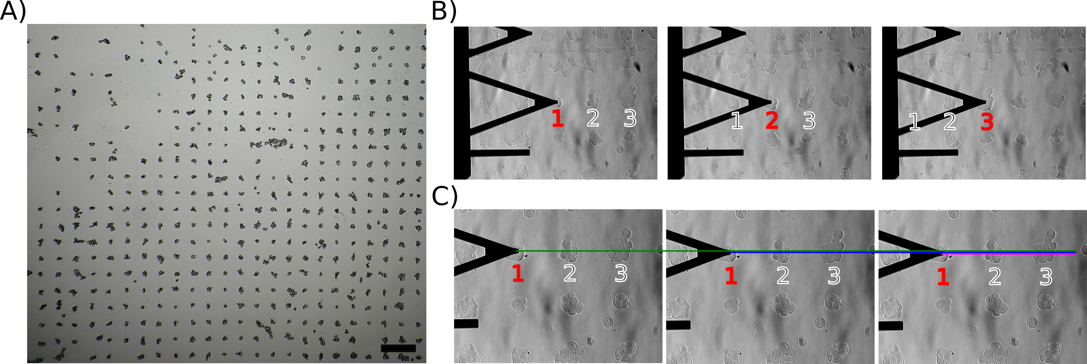
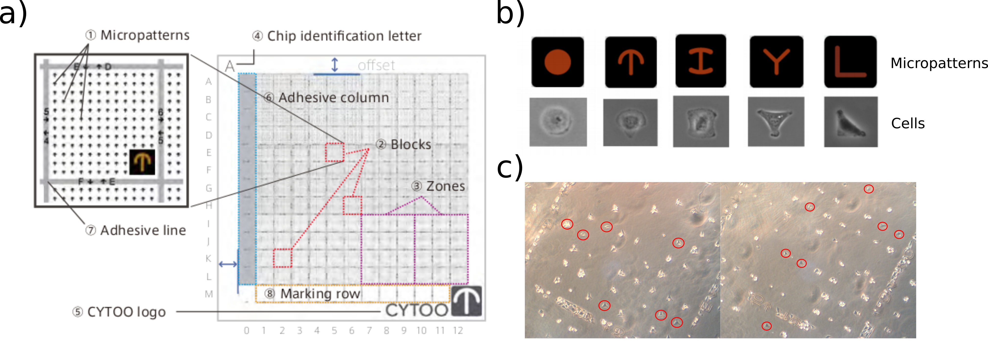
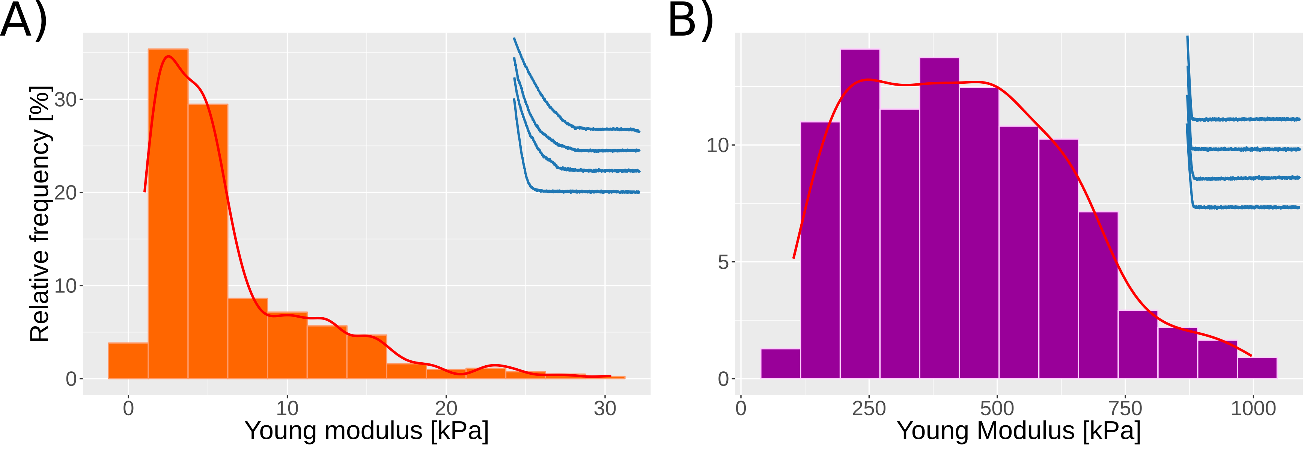
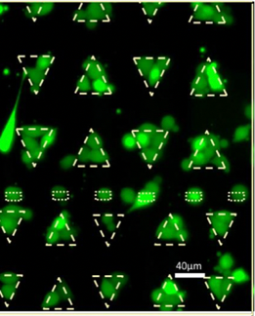

Preliminary results on mammalian cells
BIOSOFT
optimize cells immobilization, CYTOO chips or BIOSOFT
  objective: 80-90 % of filling rate; one and only one cell per pattern
evolution of the automation software to make larger displacement
CYTOO
Native HELA cells
80 cells analyzed
Fixed HELA cells
70 cells analyzed
LabCom LAAS-INNOPSYS
Mammalian cells array

Slide 20
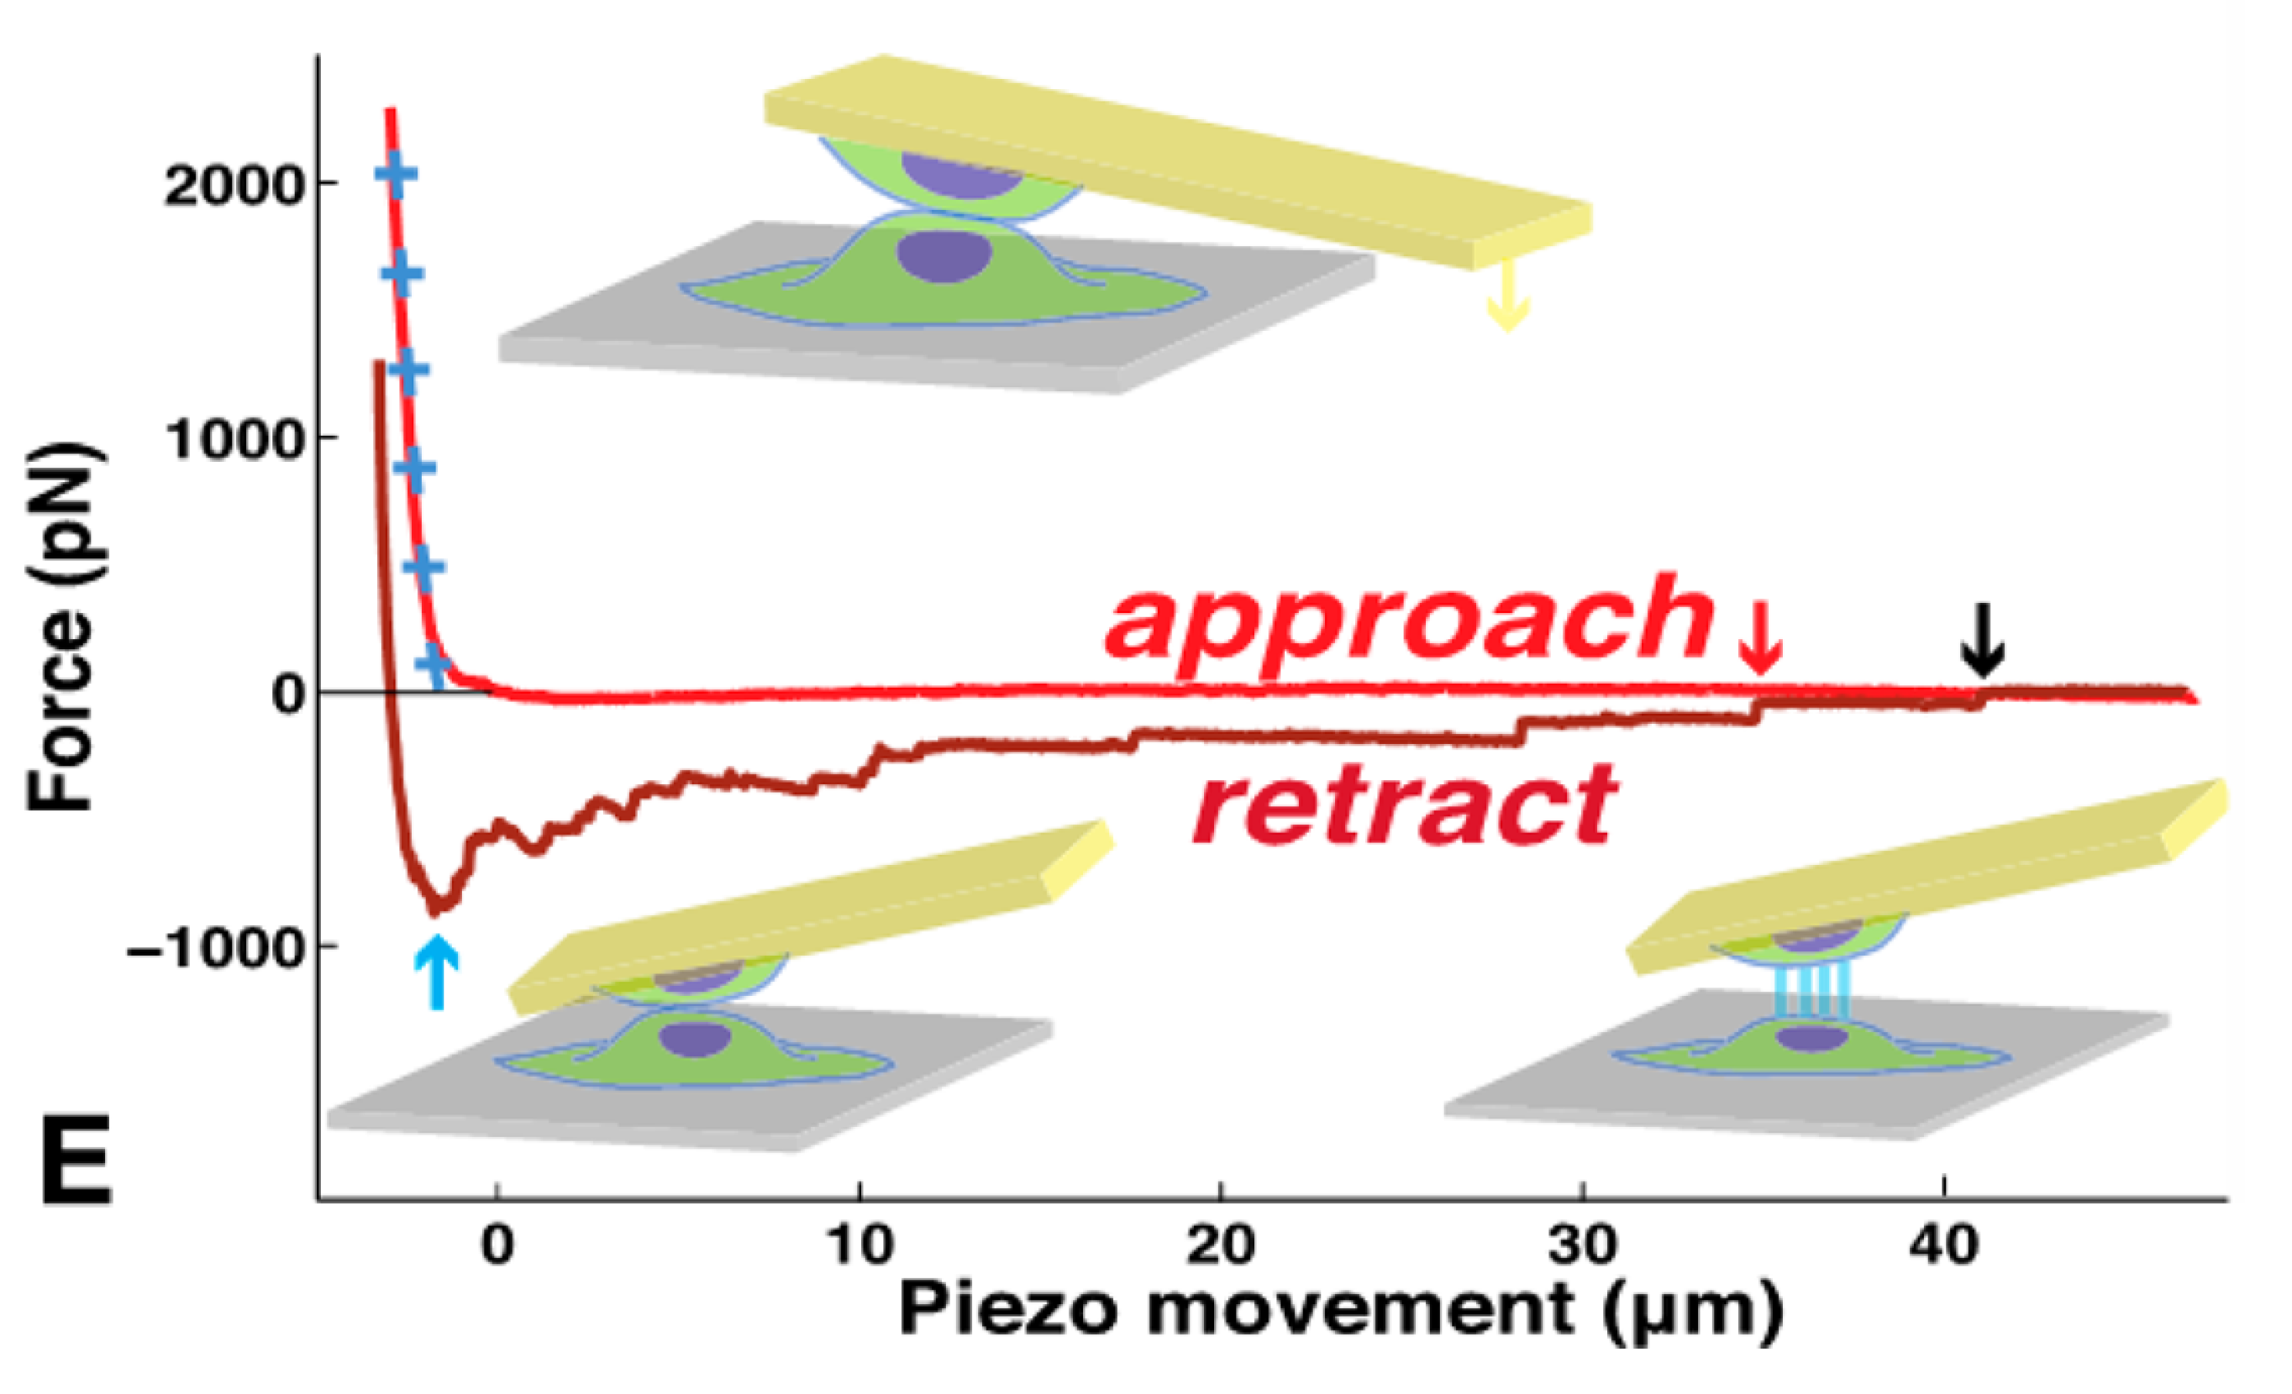
Question: which mechanobiological markers?
Smolyakov et al. 2016
ACS AMI
Approach curve :
  Stiffness, Elasticity
  Pre Stress
  Jumping on approach
  Repulsive interaction
  Shrinkage curve
Adhesion
  Number of nanotubes
  Length of nanotubes
  Breaking force of the nanotubes
  Adhesion work
Difference approach/retraction
  Dissipated energy
  Viscoelasticity as a function of the stress regime
Several mechanobiological markers allow the discrimination of breast cancer lines

Slide 21

Conclusions: AFM is
AFM creates a new way to address biological questions
  A technology for cell surface exploration
AFM gives acces to surface properties
  Bring new insight in cell surface topography, structure and function
can be use to probe cell/surface or cell/cell interactions
a single molecule or single cell technic, that can be multiplexed

Slide 22
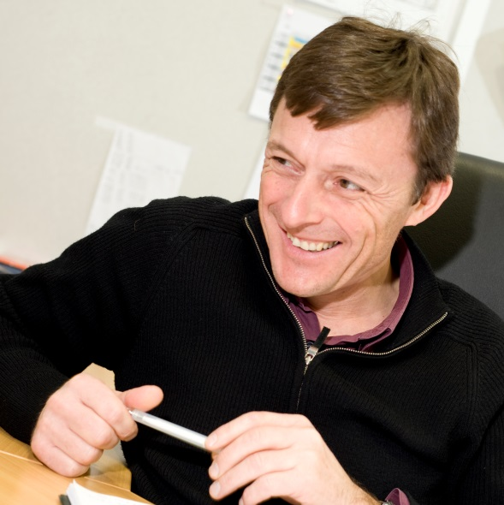
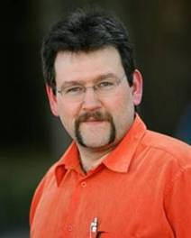
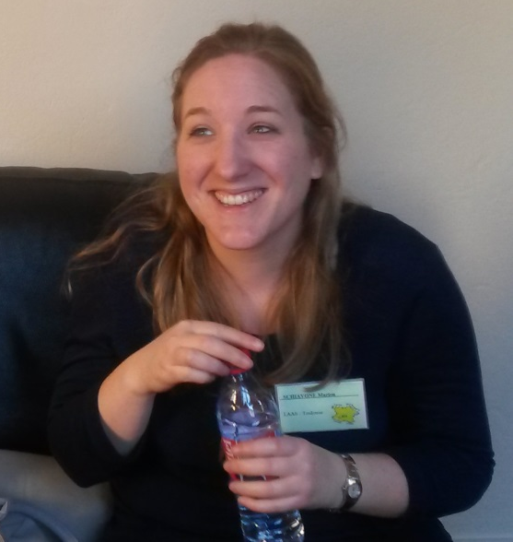
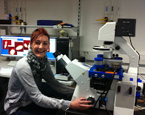
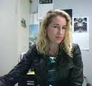
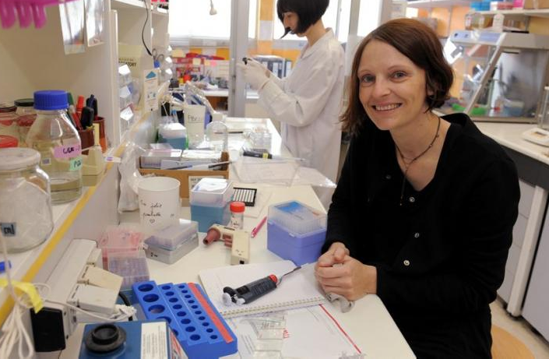
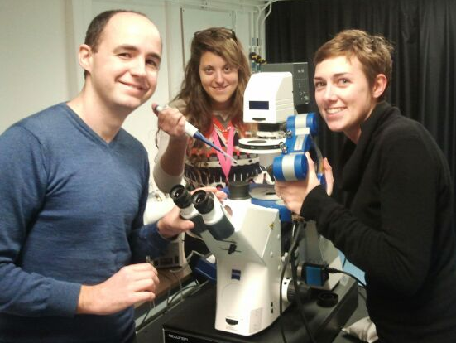
Acknowledgements: collaborators
Univ of Regina
T. Dahms, E. Ndvolu
Norwegian U of Science and Technology
M. Sletmoen, Ingrid Bakke
Liboa University
Miguel Texeira, M. Cavalheiro
University of Kiel
Martina Baum, S. Klemm
TBI
JM. Francois, H. Martin Yken, M. Mercier Bonin,
M. Castelain
IPBS
MP. Rols, F. Pillet, L. Gibot
L. Chopinet
LPCNO
L. Ressier, E. Jauvert
ITAV
C. Severac, V. Lachaize
G. Smolyakov
LAMBE
J. Pelta, S. Labdi,
B. Thiebolt, C. Campillo
I2MC
C. Gales, JM. Senard
M. Cauquil
Lallemand SAS
M. Castex, M. Schiavone
Pharmacie Nancy SRSMC
R. Duval
Pasteur Paris
C. D’enfert, JP. Latgé
Beauvais
Univ of Illinois
L. Hoyer
Univ of Aberdeen
Al. Brown
L. Walker
F. Pillet, C. Formosa,
L. Chopinet

