Slide 1
Electron Beam Lithography
Université de Technologie de Troyes - avril 2024
Electron Beam Lithography – Franck CARCENAC
LAAS – CNRS 7, avenue du Colonel Roche 31031 TOULOUSE - FRANCE

Slide 2
Purpose
Prolegomena
Overview of E-Beam Lithography (EBL):
  Knowledge, concepts, tools, tips, tricks
  2h … I made choices !
Focus on 1 kind of equipment:
  # UTT one ☺

Slide 3
Outline of presentation
  Introduction
  EBL: basic principals
    Exposure
    Developing
    System composition
    Calibration
    Design recommendations
  EBL: concrete practice
    Driving parameters
    Limitations
    Recommendations
    Sum-up
  EBL nowadays
    Competition at industry level
    Tendencies and job evolution

Slide 4
Outline of presentation
  Introduction
  EBL: basic principals
    Exposure
    Developing
    System composition
    Calibration
    Design recommendations
  EBL: concrete practice
    Driving parameters
    Limitations
    Recommendations
    Sum-up
  EBL nowadays
    Competition at industry level
    Tendencies and job evolution

Slide 5
General considerations
Introduction
Lithography:
  Greek: lithos # stone & graphia # writing
  Shaping/modifying locally a material called a "resist"
  Registering a targeted design as a ghost image inside a material called generally "resist" which will be next developed
  …
Must be though with all the other steps: technology of micro/nano fabrication
  Materials deposition: conductors, insulators, semi-conductors, topological insulators, bio-materials, …
  Materials etching : dry and wet etching, removal, …
  Characterization: physical, electrical, chemical, biological, …, aging, …
  Take always into account:
    The limits of each step
    Start by the last one ... up to integration / packaging !

Slide 6
Lithography … why electron beam ?
Introduction
  Decrease diffraction # decrease wavelength
  λ_{electrons} at 100keV = 0.0037nm
  Simple to produce, simple to shape
  Maskless (generally)
  But …
  Under vacuum
  Max. resolution few nanometers at 200kV (on bulk substrate)
  Why a so big difference between λ and ultimate resolution ?
  Electrostatic repulsion
  Lenses defects and aberrations
  Electrosensitive materials and their chemistry

Slide 7
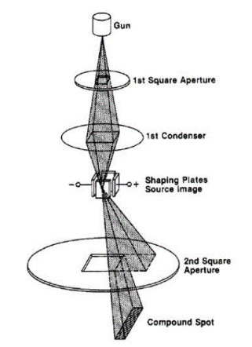
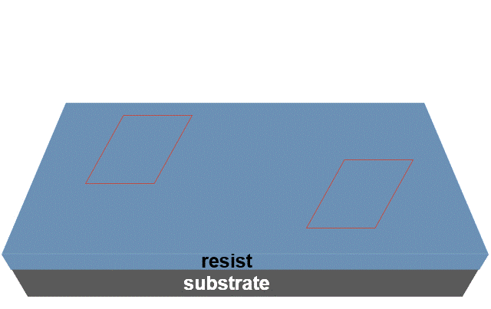
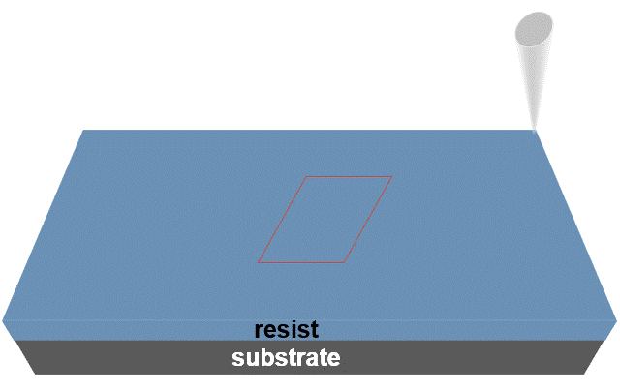
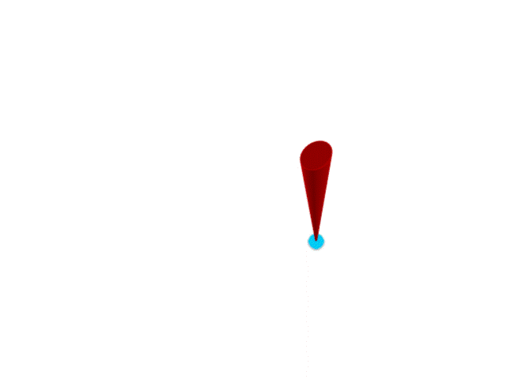
Different EBL techniques
Introduction
Beam type: Gaussian / Variable or fixed shape
  Focused beam (point per point exposure): like a SEM - Gaussian beam
  Non focused beam (area exposure):
    Projection of a variable shape
    Projection of a fixed shape (cell projection): needs a mask with holes
Scan type: Vector / Raster
  Vector scan: only necessary parts are scanned
  Raster scan: all the exposure area is scanned
  Beam is blanked when necessary
Exposure type:
  Fixed stage during exposure … field by field with stitching
  Moving stage during exposure: continuous exposure
  (e.g.: RAITH FBMS mode - avoid stitching in optical guides)

Slide 8
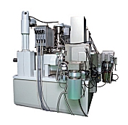
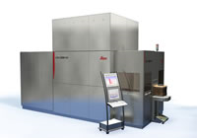
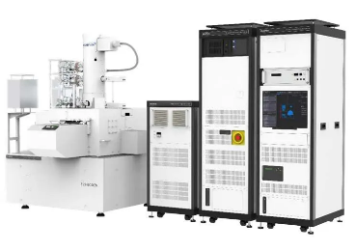
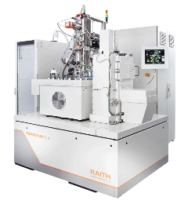
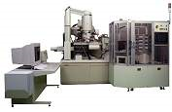
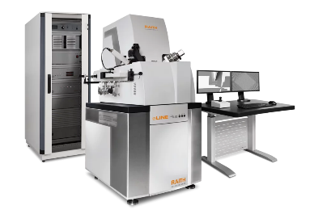
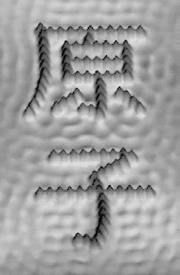
Different EBL techniques
Introduction
  Shaped beam - Vector scan - fixed / moving stage
  Cell projection (need a mask)
  Multi-beams, micro-columns
    For mask production
    High resolution (~30nm), high speed … high cost
  Gaussian beam – vector scan - fixed / moving stage
    Very high resolution … ~8nm
    Intermediate speed & cost
  STM
    Atomic resolution
    Very slow
    Low temperature (mK)
Direct writing of atomic ideograms realized and observed by AFM.
These 2 ideograms (Yuán Zĭ) mean “atom” in Chinese and are made of iron atoms on a copper surface (D.M. Eigler and Co. in IBM research center of Almaden).

Slide 9
Outline of presentation
  Introduction
  EBL: basic principals
    Exposure
    Developing
    System composition
    Calibration
    Design recommendations
  EBL: concrete practice
    Driving parameters
    Limitations
    Recommendations
    Sum-up
  EBL nowadays
    Competition at industry level
    Tendencies and job evolution

Slide 10
Exposure: resists
EBL: basic principals
Electrosensitive material:
  Also sensitive to X-Rays, UV, ions, neutrons, …
  A lot of resists used in UV-lithography are sensitive to electrons
Chemical bonds creation or break:
  Organic resist: 6 – 10eV  secondary electrons
  Inorganic resist: > 50eV  high energy electrons  beam itself  high resolution  dose increase
Positive resist:
  Chemical bonds break   molecular weight (e.g.: PMMA, PMMA/CoMAA, PMGI, ZEP520, CSAR, …)
Negative resist:
  Chemical bonds creation   molecular weight (e.g.: ma-N 2400, PMMA, calixarene, …)
Chemically amplified negative resist:
  Chemical bonds break  acid radical creation
  Thermally activated cross-linking (PEB – Post Exposure Bake)   molecular weight (e.g.: SU8, SAL601, …)
Inorganic materials:
  Phase or crystallinity change, chemical bond break or make a hole: HSQ, WO₃, SiO₂, AlF₃…)

Slide 11
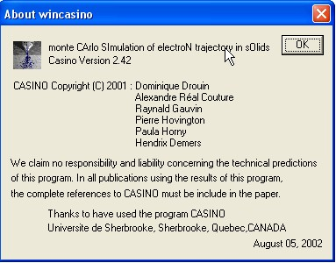
Exposure: where does it take place ?
EBL: basic principals
Close to electrons’ trajectories
http://www.gel.usherbrooke.ca/casino/

Slide 12
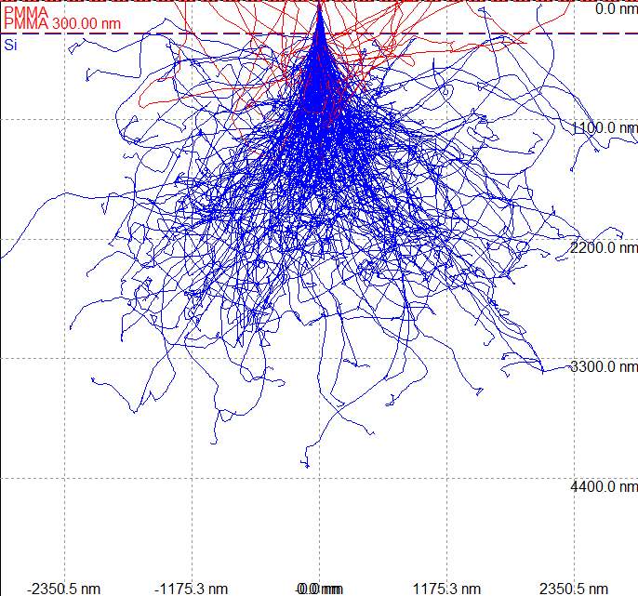
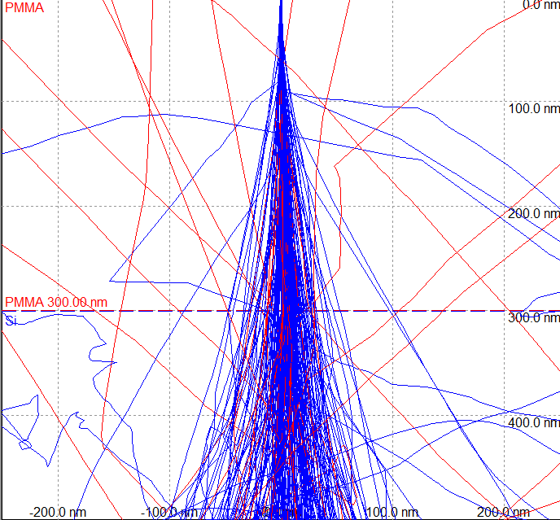
Exposure: electrons' trajectories
EBL: basic principals
Modification of the molecular weight
Scattering leads to creation of a molecular weight gradient
Additive effects (organic resist)
    proximity effect

Slide 13
Exposure: Beam Point Spread Function
intensity
EBL: basic principals
I_{beam}
defects density contribution of backscattering :
Low density #  molecular weight
(for a positive organic resist)
defects density contribution of forward scattering :
High density #    molecular weight
(for a positive organic resist)
I_{backscattered}
distance from beam impact
☞ 2 gaussian curves model

Slide 14
Outline of presentation
  Introduction
  EBL: basic principals
    Exposure
    Developing
    System composition
    Calibration
    Design recommendations
  EBL: concrete practice
    Driving parameters
    Limitations
    Recommendations
    Sum-up
  EBL nowadays
    Competition at industry level
    Tendencies and job evolution

Slide 15
Developing
EBL: basic principals
EBL results from lithography + developing
Organic resist:
  No dissolution
  Put in solution:
    Solvent cage around the polymer fragments
    Transport phenomenon in the solution:
      Speed is inversely proportional to Molecular Weight
      Can be difficult in small openings
      i.e. high resolution: <10nm holes in thick positive tone resist
Inorganic resist:
  Chemical reaction with acid or base (HSQ, WO₃, SiO₂)
  Self-developing (AlF₃)

Slide 16
Developing: resist contrast
normalized thickness
normalized thickness
EBL: basic principals
1
1
Negative
Positive
0
0
Dₙ
Log dose
Dₚ
Log dose
Development speed = f(molecular weight, concentration, duration, temperature)
Contrast γ # curve slope
High contrast # high selectivity on molecular weight
  Vertical walls
  Higher process latitude
  Higher resolution
  Less sensitive to proximity effects
Low contrast:
  2.5D lithography / grey scale lithography - e.g. optical microlens fabrication

Slide 17
Developing: resist profile
EBL: basic principals
Region of the lowest molecular weight
(positive resist)
Molecular weight increases
(positive resist)

Slide 18
Developing: proximity effects
EBL: basic principals
Molecular weight modification is additive on organic resists
development threshold D_{n} or D_{p}

Slide 19
Developing: proximity effects
EBL: basic principals
Positive resist
Substrate : Si

Slide 20
Developing: proximity effects
EBL: basic principals
Molecular weight modification is additive on organic polymers
… and can lead to proximity effect:  resolution
development threshold D_{n} or D_{p}

Slide 21
Developing: proximity effects
EBL: basic principals
Positive resist
Substrate : Si

Slide 22
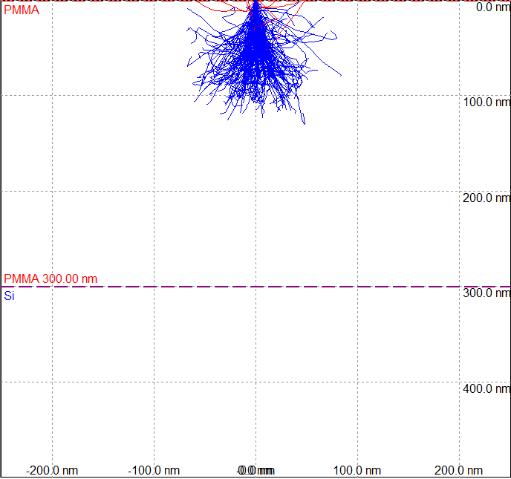
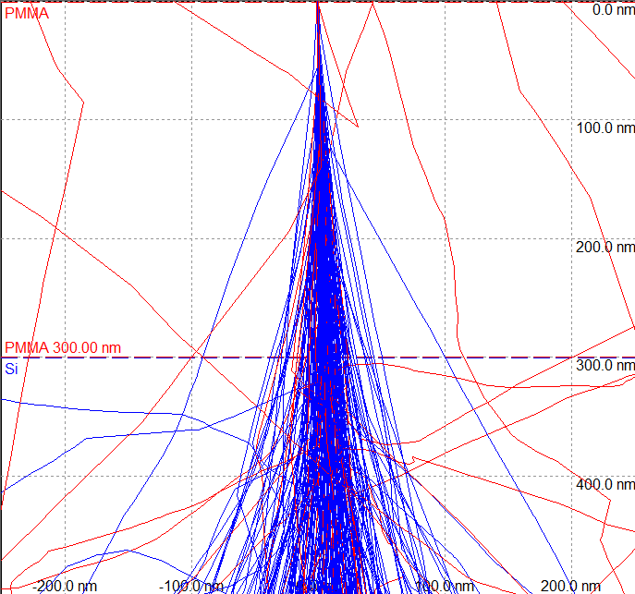
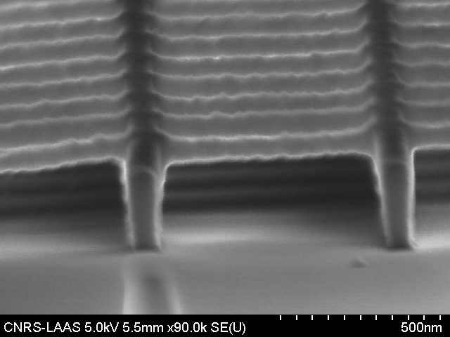
Exposure: special …
EBL: basic principals
1st grating exposed at 20keV
  2 exposures: 20keV – 2keV
  Negative resist
  Design: 2 superimposed perpendicular gratings
  1 development
  Suspended structures
2nd grating exposed at 2keV
~100nm
Tilted view

Slide 23
Outline of presentation
  Introduction
  EBL: basic principals
    Exposure
    Developing
    System composition
    Calibration
    Design recommendations
  EBL: concrete practice
    Driving parameters
    Limitations
    Recommendations
    Sum-up
  EBL nowadays
    Competition at industry level
    Tendencies and job evolution

Slide 24
System composition
Computer Assisted Design (CAD) software
Electron optics and detectors:
  SEM-like
  SEM imaging capabilities (SE & BSE)
Beam blanker
Pattern generator: for beam scanning control (electronics)
Software: link between user / CAD / beam scanning / beam blanking, …
Minimum configuration
Able to work on one field only
EBL: basic principals

Slide 25
System composition
EBL: basic principals
Pattern bigger than one field:
  Pattern is cut into fields
  Fields stitching (≤50nm precision on Raith e-line machine)
Need of a LASER interferometer:
  Position precision measurement: 2nm or less (0.15nm)
  Reference for moving
  Allow field calibration: size, rotation & shift

Slide 26
System composition: synoptic
EBL: basic principals
electron beam
scanning data
A’: reached position
(mechanical precision ⇨ ~1µm)
scanning system
scanning
amplifier
A: position to reach
(precision ~1nm)
offset calculation
mirror
A
A’
•
Stepper motors
interferometer
sample
STAGE
piezos amplifier
piezos. elts

Slide 27
System composition: remarks
EBL: basic principals
Specimen not always in the axis of mechanical displacement: authorized misalignment 2°
  Alignment registration on sample edge/flat/notch
  Software correction (mechanical precision)
SEM fields are limited in size and position:
  Big field # big distortions
  Not always in the axis of mechanical displacement (electromagnet lenses)
  Be careful: electronic rotation induces distortions (non-linear electronics)
Field size is not calibrated
  Need a mark to calibrate the machine: first level exposure
  Need reference marks made by a calibrated machine: next levels exposure
Electron optics with low distortions
Stepper motors (precision: 1 or few µm)

Slide 28
Outline of presentation
  Introduction
  EBL: basic principals
    Exposure
    Developing
    System composition
    Calibration
    Design recommendations
  EBL: concrete practice
    Driving parameters
    Limitations
    Recommendations
    Sum-up
  EBL nowadays
    Competition at industry level
    Tendencies and job evolution

Slide 29
Field calibration
EBL: basic principals
Field is a trapezoid ⇨ calibration
  Coordinate system transformation
  Define XY unit vectors value (field size)
  Define angle between XY unit vectors
  Define rotation (allowed 2° … if more image rotation is added)
  Define shift between imaging and lithography scanning ?
3 unknown parameters (field size, rotation, shift): 3 XY mismatch measurements
Can be done by means of:
  Calibrated sample with marks (without LASER interferometry): sample do not move
  Using LASER interferometry: reference point is moved within the field area

Slide 30
Field calibration: stitching
EBL: basic principals
Before field calibration
With interferometric measurement only
After field calibration

Slide 31
Outline of presentation
  Introduction
  EBL: basic principals
    Exposure
    Developing
    System composition
    Calibration
    Design recommendations
  EBL: concrete practice
    Driving parameters
    Limitations
    Recommendations
    Sum-up
  EBL nowadays
    Competition at industry level
    Tendencies and job evolution

Slide 32
Design recommendations: file type - softwares
EBL: concrete practice
Drawings’ file type:
  World-famous GDSII (binary files) … DXF, ASCII, …, conversion possible
  DATATYPE parameter used for dose coding (be careful DATATYPE=1000 means DoseFactor=1)
Softwares used:
  Best one: E-Beam writer's software
  If not: must be compatible with the machine
    Klayout (include a PYTHON library … useful for scripting GDS2 files)
    CADENCE, LayoutEditor, CleWin (GDS hierarchy not fully compatible with RAITH)
    GenISys Beamer:
      Process simulation
      Data preparation/correction
      Powerful but expensive (100k€)

Slide 33
Design recommendations: drawing/design
EBL: concrete practice
Drawing’s grid must match the step-size of exposure
  To prevent coordinates from being rounded by the machine without control
Design is exposed with an orthogonal matrix XY of points:
  All structures non-parallel to X or Y axis are divided in small parts in order to fit the drawing : time and memory consuming
  Try to follow the axes
Avoid nanostructures with stitching
  Better in the center of one field

Slide 34
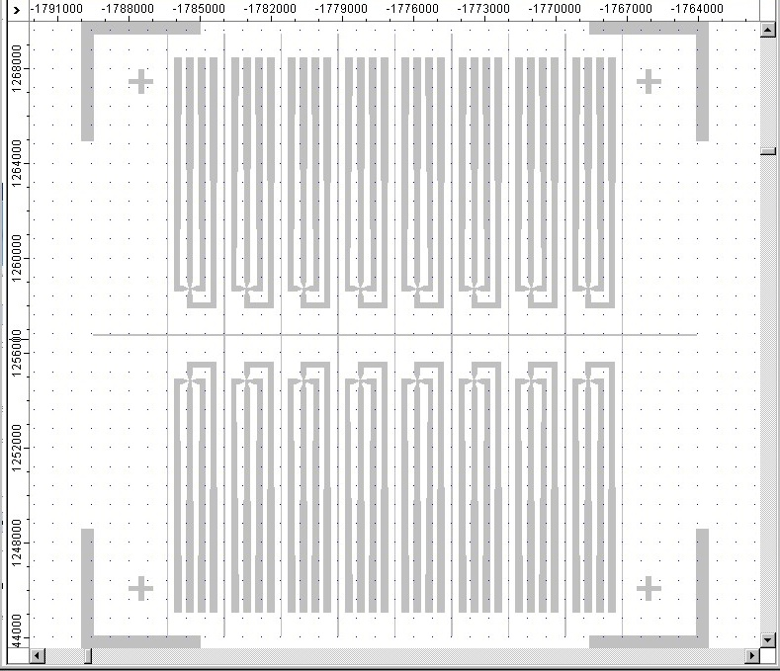
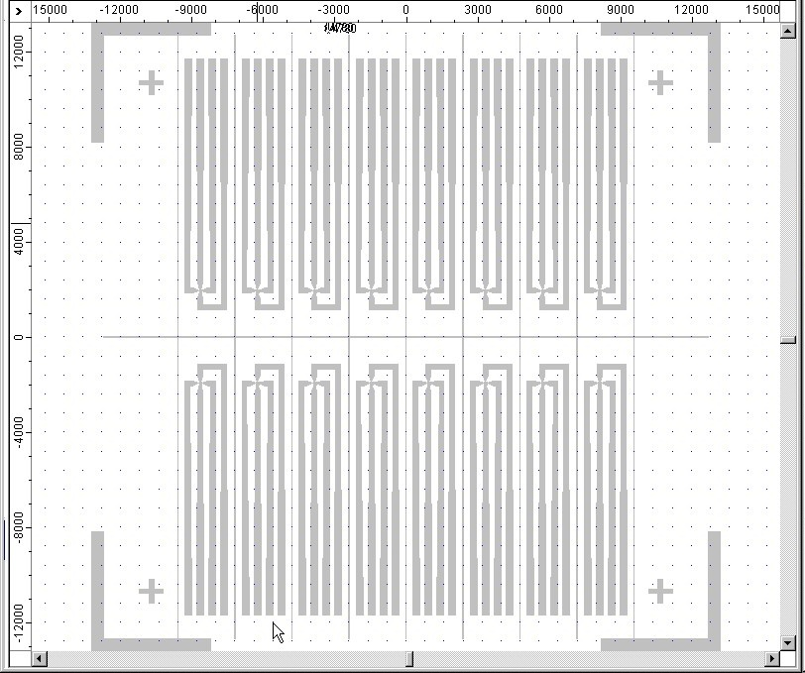

Design recommendations: drawing without knowledge
WHAT IS THE DIFFERENCE BETWEEN THE 2 IMAGES
EBL: concrete practice
DRAW CLOSE TO THE CENTER
CLUE :
they have the same scale (µm)

Slide 35
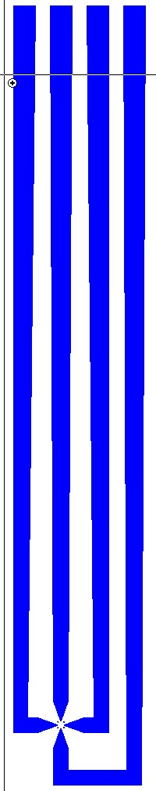
Design recommendations: drawing without knowledge
WHAT IS CURIOUS ON THIS DRAWING ?
EBL: concrete practice
Promote X-Y axis parallelism for drawing
If not, this will lead to subdivision of drawing
and exposure time increase.
CLUE :
This is not an effect from the display

Slide 36
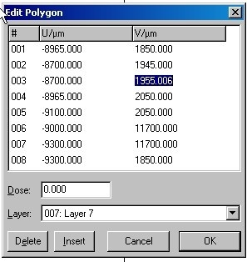
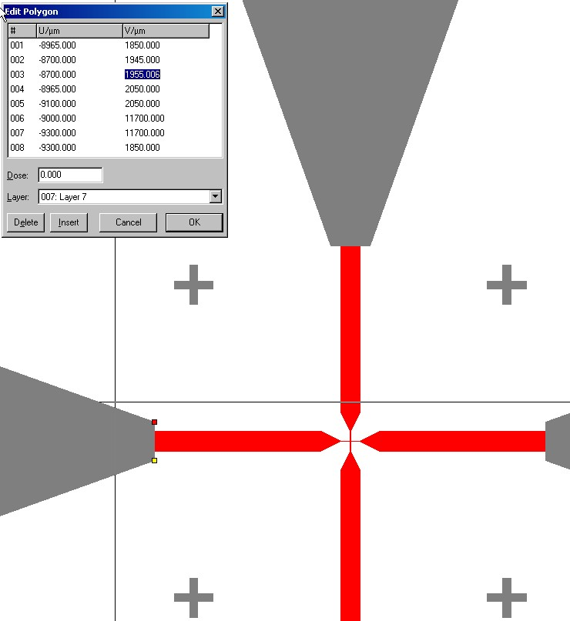
Design recommendations: drawing without knowledge
EBL: concrete practice
If not necessary: fit all values to microns or multiple
USE ADAPTED DESIGN GRID(S)
The smallest design grid step should be the exposure step-size:
ASK FOR THE VALUE !
SNAP TO GRID !
SNAP TO ELEMENTS !

Slide 37
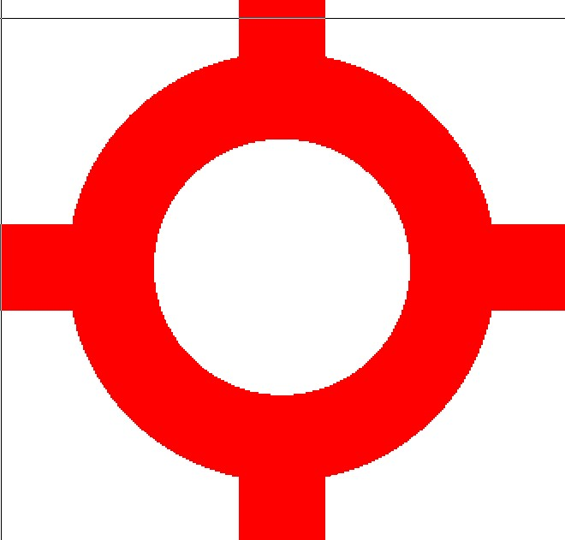
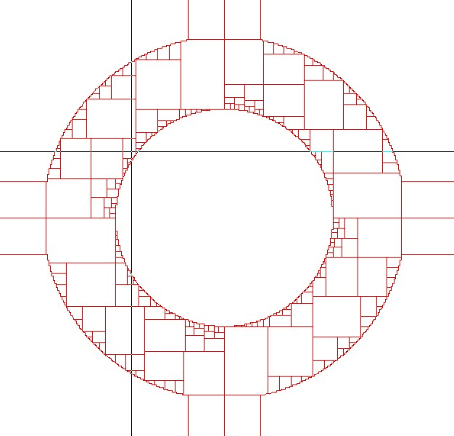
Design recommendations: drawing without knowledge
WHAT IS THERE BEHIND THE DRAWING ?
EBL: concrete practice
50nm
ALWAYS HAVE A LOOK TO DRAWING
WITHOUT THE “FILL” OPTION !

Slide 38
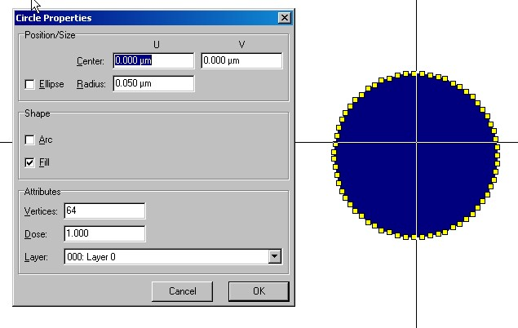
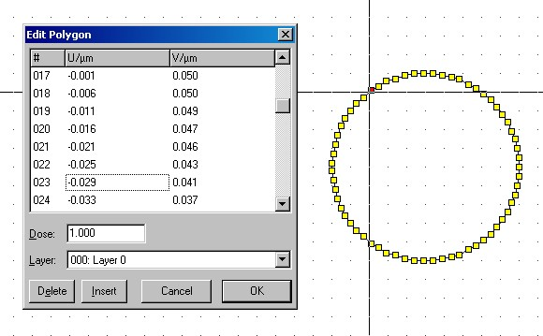
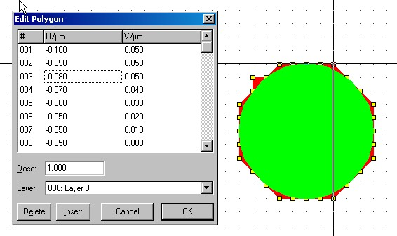

Design recommendations: rounding effect
EBL: concrete practice
EXPOSURE RESULT CAN BE DIFFERENT FROM THE DRAWING

Slide 39
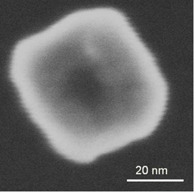
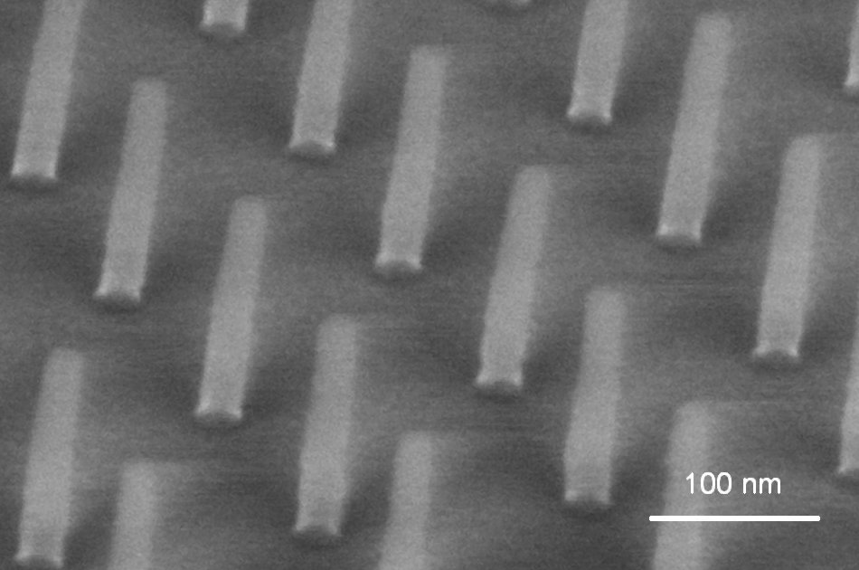
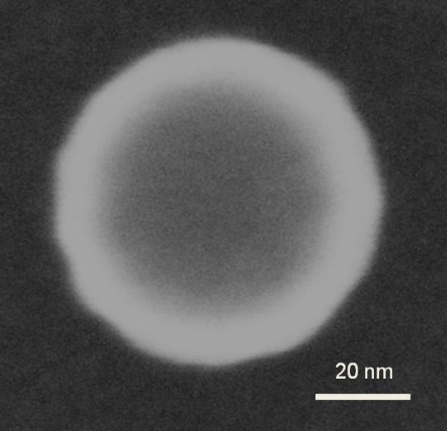
Design recommendations: rounding effect
EBL: concrete practice
Circle: Ø 50nm
Exposure step-size: 10nm
Ø = 20 nm
Circle: Ø 50nm
Exposure step-size: 2nm

Slide 40
Outline of presentation
  Introduction
  EBL: basic principals
    Exposure
    Developing
    System composition
    Calibration
    Design recommendations
  EBL: concrete practice
    Driving parameters
    Limitations
    Recommendations
    Sum-up
  EBL nowadays
    Competition at industry level
    Tendencies and job evolution

Slide 41
Driving parameters: design exposure
EBL: concrete practice
developed size ≈ beam size x 3 (min.)
beam size
P_{x}
P_{y}
drawing size  desired size – developed beam size

Slide 42
Driving parameters: exposure dose
EBL: concrete practice
total number of points
Area dose:
Line dose:
Point dose:
X size
Y size

Slide 43
Driving parameters: exposure dose
EBL: concrete practice
Depends on:
  Substrate
  Energy
  Resist: nature, thickness
  Developer: nature/concentration, duration, mechanical agitation, temperature
  Design: size/pitch/distance between structures (proximity effects), way of exposure, …
Also depends on user’s experience

Slide 44
Outline of presentation
  Introduction
  EBL: basic principals
    Exposure
    Developing
    System composition
    Calibration
    Design recommendations
  EBL: concrete practice
    Driving parameters
    Limitations
    Recommendations
    Sum-up
  EBL nowadays
    Competition at industry level
    Tendencies and job evolution

Slide 45
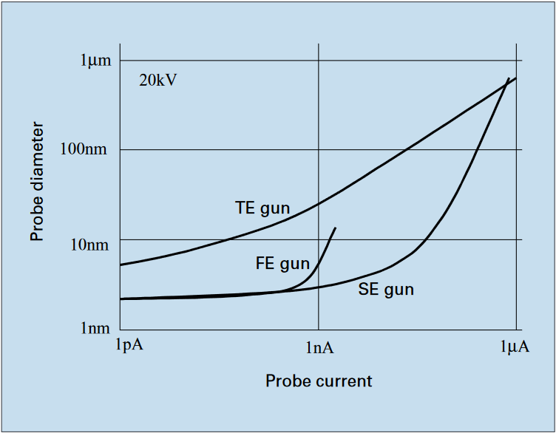
Limitations: beam diameter = f(current)
EBL: concrete practice
Beam diameter almost constant at "low current" 

Slide 46
Limitations
EBL: concrete practice
Beam size does not depend so much on current …. using a S-FEG gun
"t_{point}" limited by scanning generator maximum frequency
"p_{x}" define the Line Edge Roughness (LER)
For equipment based on standard scan coils:
  Beam speed: p_{x}/t_{point} limited by scan coils frequency bandwidth
Line Width Roughness (LWR) and LER depend on noises:
  Mechanical & acoustic vibrations
  Electric/magnetic fields
  Electronics noises,
  Temperature variation …

Slide 47
Limitations: beam speed effect
EBL: concrete practice
Origin : scan-coils (inductance)
Induce phase-shift between command and beam position
Command
Drawing
Beam position
Drawing
Result
Franck CARCENAC - University of Toulouse - CNRS-LAAS – France franck.carcenac@laas.fr

Slide 48
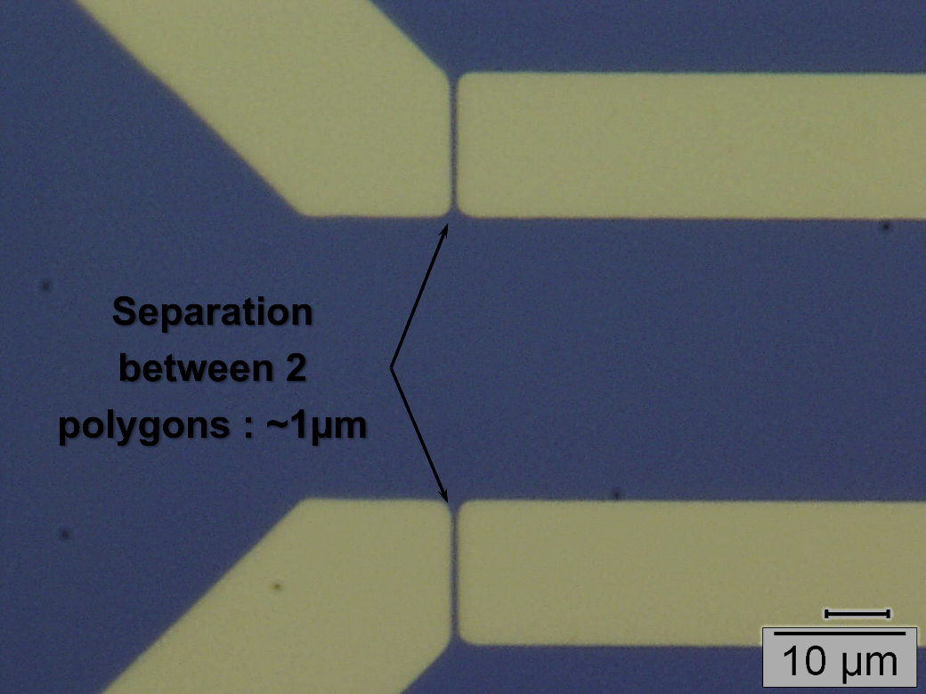
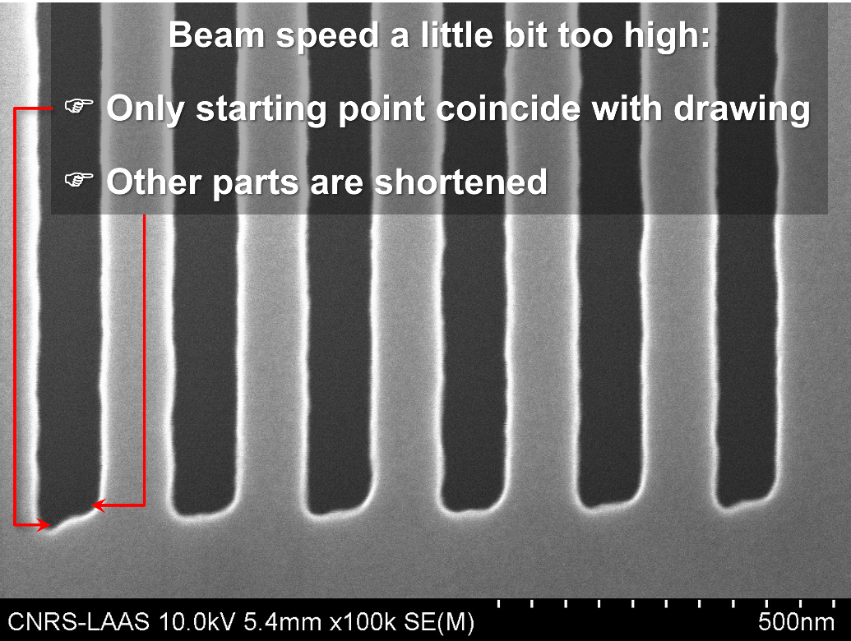
Limitations: beam speed effect
EBL: concrete practice
1μm stitching error between 2 polygons induced by a too high beam speed when using SEM scan coils for patterning
Cut the polygons and overlap parts if needed
Distortion at beginning of each line induced by a too high beam speed when using SEM scan coils for patterning

Slide 49
Exposure parameters: limiting factors
EBL: concrete practice
  Surface too large: exposure time ≈ ∞
    Minimize the surface – moderation of request
    « Mix & Match » - huge surfaces made by photolithography
  Pitch between points: define the Line Edge Roughness (LER)
    Pitch ≈ 1/3 minimum point diameter after developing
    Linked to beam diameter (and developing): if Φ_{beam}  p can 
    Does not change the exposure time: if p  t_{point}  (i.e.: F )
    Define the maximum current according to the maximum frequency
  Highest current: to decrease exposure time
    I   reach max. beam speed (~5mm/s)   pitch  max LER  I_{max}
  Higher sensitive polymer: to decrease exposure time
    Reach F_{max}   p if possible or  I   time exposure (interesting ?)
  Decrease the HV (dose=f(HV)): to decrease exposure time
    HV  (beam size , penetration depth )  dose   F  and/or p  (interesting ?)
For equipment based on standard scanning coils

Slide 50
Exposure parameters: compromises
EBL: concrete practice
Current / beam energy / pitch between points / field size / resist / technology / reasonable time … need experience
Stage movement between fields, beam stabilization time, data transfer, …
  Can double exposure time
Always too long …
  e.g.: 1cm² of 150nm square fully random with a precision of 10nm on each structure
    10Go data, 100h exposure … on a machine equivalent to UTT one (20keV, 10MHz, 135pA)
    Because of the combination of resolution and precision, current must be low  exposure time is high.
    1h on a more powerful machine (100keV, 5nA, 125MHz)
    If scanning generator maximum frequency is higher, current can be increased while maintaining a good resolution
  Collaboration with RENATECH (CNRS public facilities/clean-rooms network) could be a solution for exceptional needs.

Slide 51
Extrinsic limitations
EBL: concrete practice
Beam drift:
  Room air-conditioning stability: ~ 0.1 - 0.5°C/h
  E-beam writer temperature stability (chiller temperature control: ±0.1°C)
  Mechanical drift: holder/machine temperature
  (mechanical expansion: ≈ 1µm/0.1°C of variation)
Magnetic fields: powering cables, motors,…
Earth magnetic field: perturbation by moving heavy metal parts (vehicles, lift)
Mechanical vibrations: building, lift, vehicles, pumps, compressor, …, sound
Flat / structured substrate: depth of focus, variable resist thickness, …

Slide 52
Intrinsic limitations
EBL: concrete practice
Electronics quality:
  Speed
  Noise
  Stability
  Reliability
DAC:
  Number of bits
  Maximum frequency
Scanning:
  Beam scanning: frequency bandwidth
  Field or field + subfields
  Matrix correction: 4 points or more
  Dead times:
    Stabilization: stage, beam
    Data transfer and treatment
Computer:
  PC under Windows
  Workstation under LINUX
Beam blanking speed
…

Slide 53
Outline of presentation
  Introduction
  EBL: basic principals
    Exposure
    Developing
    System composition
    Calibration
    Design recommendations
  EBL: concrete practice
    Driving parameters
    Limitations
    Recommendations
    Sum-up
  EBL nowadays
    Competition at industry level
    Tendencies and job evolution

Slide 54
Recommendations: EBL from A to Z
  Project / design to realize
  Adjustments
  Exposure / development
  Characterization / measurements
  Is it simple ?
EBL: concrete practice
Bibliography, description, bottlenecks, issues …
watch out for proximity effects, total surface, …
Like a SEM column !
Do you know how to use the E-beam machine ?
Easy to do !
Do I know how to use dedicated machines !?!
yes … with experience

Slide 55
Recommendations: technology integration
EBL: concrete practice
Elements to take into account:
Sample :
  Conductor / insulator ?
  Sensitive to electrons ?
  Size / shape / fragility / surface roughness / flatness / available quantity for tests / price / …
Particular properties for the resist and/or sample specificity:
  Previous and next technological steps?
  Sensitivity or resistance towards treatments: wet/dry etching, solubility, compatibility with metals, … ?
  Positive or negative ?
  Final structure: bump or hole ? surface / density / size ?
  Etching or lift-off ?
  Resolution, thickness, dose, developer ?
  Easy to remove ?
Alignment marks : overlay, « mix & match »

Slide 56
Outline of presentation
  Introduction
  EBL: basic principals
    Exposure
    Developing
    System composition
    Calibration
    Design recommendations
  EBL: concrete practice
    Driving parameters
    Limitations
    Recommendations
    Sum-up
  EBL nowadays
    Competition at industry level
    Tendencies and job evolution

Slide 57
Sum-up of SEM - EBL courses
EBL: concrete practice
SEM:
  Alignment and astigmatism routines:
    Round shape beam (no astigmatism)
    Minimum size (highest resolution) for the parameters used
  More and more simple:
    Automatic alignment
    Automatic adjustments
  Needs experience to choose the right parameters:
    Share informations
    Try new parameters set: your ability in alignment and astigmatism routines allow you to explore quickly different parameters
  Useful for EBL adjustments
EBL
  Need of experience # need to practice & share knowledges
  Adjustments, calibrations, exposure, developing, characterization … it takes time to be confident
  When facing issues you will learn why and how to overcome them

Slide 58
Sum-up manufacturers
EBL: concrete practice
Raith
Jeol
ELIONIX
Vistec
Advantest
Crestec
Nanobeam
Nabity: Nano Pattern Generation System
Hitachi

Slide 59
Outline of presentation
  Introduction
  EBL: basic principals
    Exposure
    Developing
    System composition
    Calibration
    Design recommendations
  EBL: concrete practice
    Driving parameters
    Limitations
    Recommendations
    Sum-up
  EBL nowadays
    Competition at industry level
    Tendencies and job evolution

Slide 60

Competition at industry level: 20 years ago …
EBL nowadays
10³
increase resolution
10²
EUV
DUV
10
Nano-Imprint ?
Multiple e-beam ?
?
increase speed
MINIMUM SPEED REQUIRED
FOR PRODUCTION
1
X- RAYS ?
10⁻¹
ELECTRONS: CELL PROJECTION
writing speed cm²/s
10⁻²
ELECTRONS : SHAPED BEAM
10⁻³
ELECTRONS : FOCUSED BEAM
IONS : FOCUSED BEAM
10⁻⁴
MASS PRODUCTION
☞ NEED MASK
10⁻⁵
STM - AFM
DIRECT WRITING
MASK-LESS
10⁻⁶
0,001
0,01
0,1
1
10
RESOLUTION - μm

Slide 61

International project
EBL nowadays

Slide 62
Competition at industry level: nowadays !
EBL nowadays
10³
increase resolution
10²
EUV
DUV
10
Nano-Imprint ?
Multiple e-beam ?
?
increase speed
MINIMUM SPEED REQUIRED
FOR PRODUCTION
1
X- RAYS ?
10⁻¹
ELECTRONS: CELL PROJECTION
writing speed cm²/s
10⁻²
ELECTRONS : SHAPED BEAM
10⁻³
ELECTRONS : FOCUSED BEAM
IONS : FOCUSED BEAM
10⁻⁴
MASS PRODUCTION
☞ NEED MASK
10⁻⁵
STM - AFM
DIRECT WRITING
MASK-LESS
10⁻⁶
0,001
0,01
0,1
1
10
RESOLUTION - μm

Slide 63
Outline of presentation
  Introduction
  EBL: basic principals
    Exposure
    Developing
    System composition
    Calibration
    Design recommendations
  EBL: concrete practice
    Driving parameters
    Limitations
    Recommendations
    Sum-up
  EBL nowadays
    Competition at industry level
    Tendencies and job evolution

Slide 64
Tendencies: EBL still alive
EBL nowadays
Still necessary for:
  Optical mask fabrication: UV, DUV, EUV
  Molds fabrication: Nano Imprint Lithography (molding)
Large surfaces:
  Optical metasurfaces: ~1cm² and more … if possible
    Structures are not regular
    Large surface
    High resolution
    Critical Dimension (CD) control: ~10nm
  Improve machines: current, speed, resolution
  Improve resists: sensitivity, contrast, etching resistance, …

Slide 65
Job evolution
Machines more and more automatic:
  Focus
  Astigmatism
  Calibrations
User: closer and closer to technology
  Scientific project, materials compatibility, flow chart, characterization
  There is still plenty of knowledges to acquire
Scripting (big tendency):
  For complex and variable drawings
  To drive the machine
  Learn programming languages:
    PYTHON, RUBY, MATLAB, …
    Probably deep learning to extract parameters from a collection of exposures
EBL nowadays

Slide 66
EBL to do what ? Answer some questions …
You search for a lithography solution
R&D / production ?
Large areas exposure - mask making / big samples ?
High throughput or high number of samples / high speed ?
High resolution (nanostructures) ?
Small area : one field exposure (simplest system) ?
Large area : field cannot be as large as the area ?
    Stitching between fields
    High precision stage: moving and control (feedback)
Multi-level alignment : mark detection, overlay ?

Slide 67
EBL to do what ? Answer some questions …
You want to use an existing machine:
What is your project ?
Did you make some bibliography ?
What are the limits of the machine ? Do they match your requirements ?
Accessibility: for use on your own (needs training), availability
Have you been trained for technology/fabrication ?
Do you need high/low resolution ? Both ?
Do you need precision ? Which one ?
Do you need overlay ? If yes: what about alignment marks ?
Detailed description of your sample ?
Detailed description of previous/following steps ?
Do you need a specific compatibility ?

Slide 68




Exposure parameters: other limiting factors
  Field stitching can increase dramatically exposure time:
    Mechanical displacements:
    From almost nothing to few seconds: depending on the distance
    Stabilization time: 3s
    Focus correction (automatic): 1s
    Alignment: ~5s
  Proximity effect correction:
    Increase the total settling time by number of objects increase
    To minimize : apply correction only where needed
"Exposure time" : 15s (without PEC)
3mn 20s (with PEC)

Slide 69
Strategy to speed up EBL: 2 currents & 2 field-size
Possible solution:
    Small structures made at low current low field-size
    Big structures made at high current and large field-size
Needs:
    Define the required total overlay precision (this will define the way to make them)
    Alignment marks (could be made by optical lithography)
  Advantages: everything is made by EBL … only one machine
  Example : if there is not too much area to do
  8 contact pads of 150x150µm² & nanostructures in 100x100µm²
    High resolution : 20kV, 135pA, 100µm field-size, step-size 10nm
    Low resolution : 20kV, 1-5nA, 800µm field-size, step-size 100nm
Drawback: beam-speed effect for low resolution step

Slide 70
Automatic Mark Detection: Linescan
Why only automatic ?
  Manual alignment on images:
    you are obliged to be in front of the machine
  Automatic with images:
    Depend on signal
    Precision depend on image size:
      High magnification # small possibility for misalignment
      Low magnification # small precision
    Depend on mark quality
    Observation = exposure: lift-off destroy all the mark
  Automatic mark detection is reliable and efficient

Slide 71
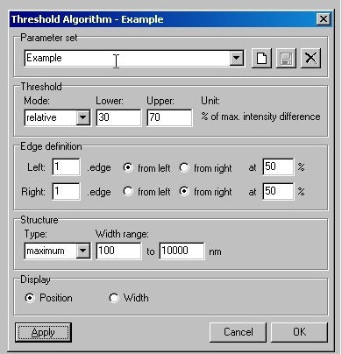
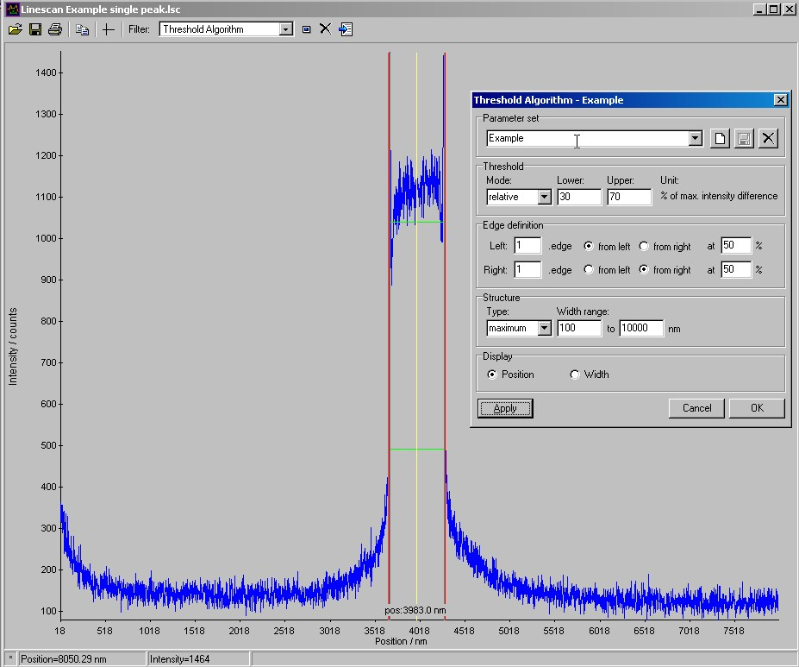
Automatic Mark detection

Slide 72
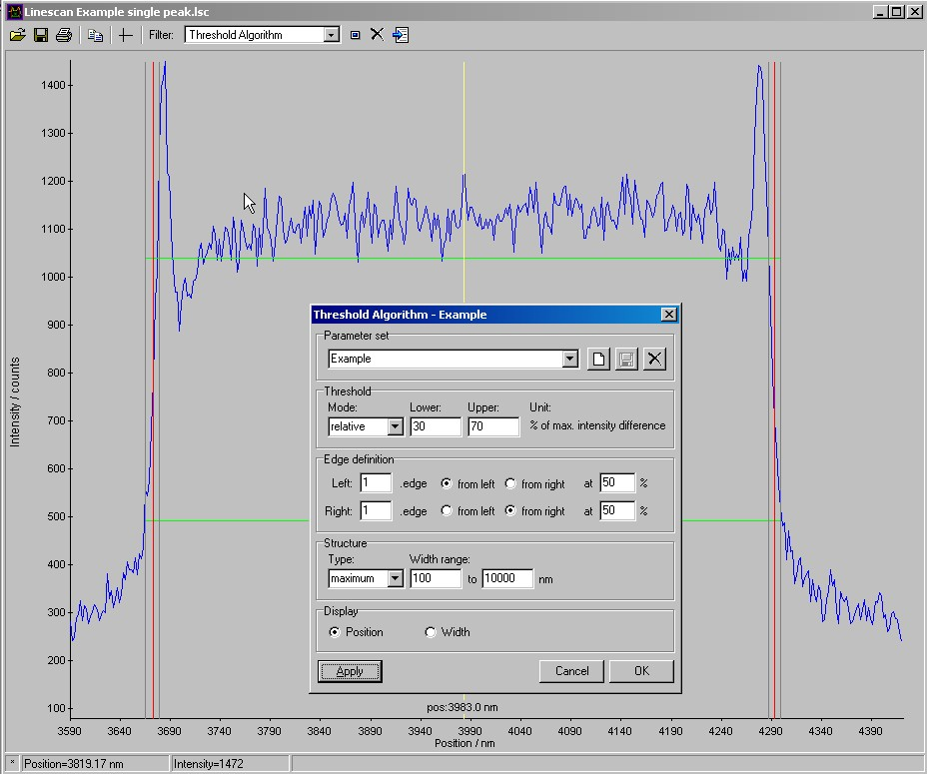
Automatic Mark detection

Slide 73
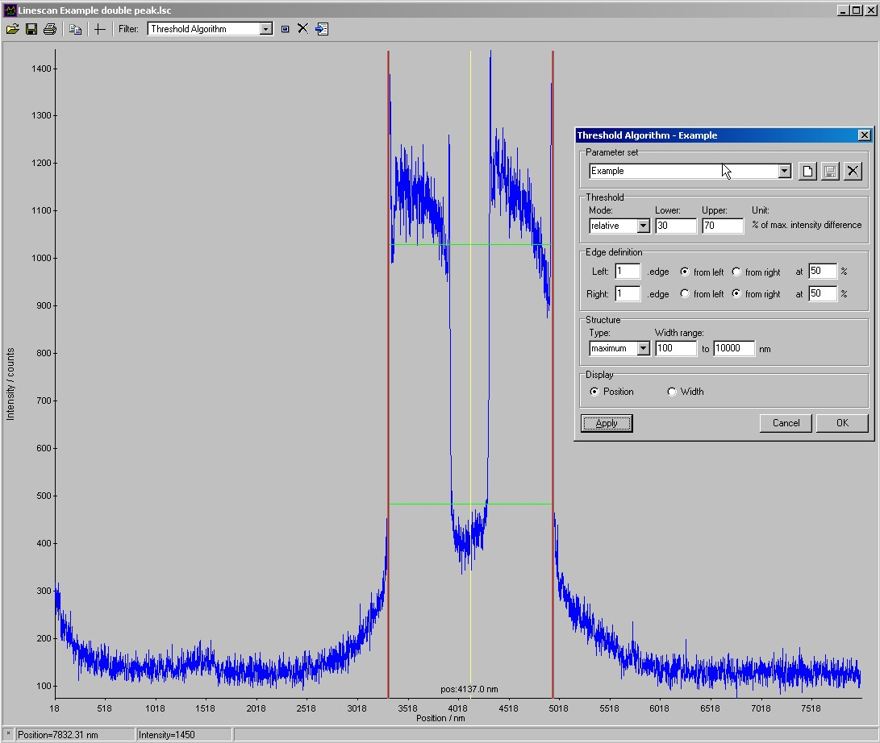
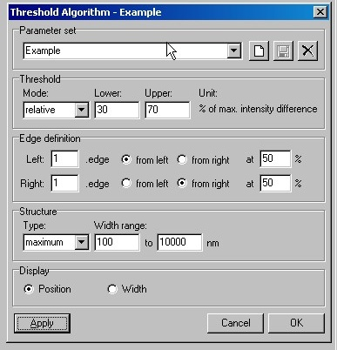
Automatic Mark detection

Slide 74
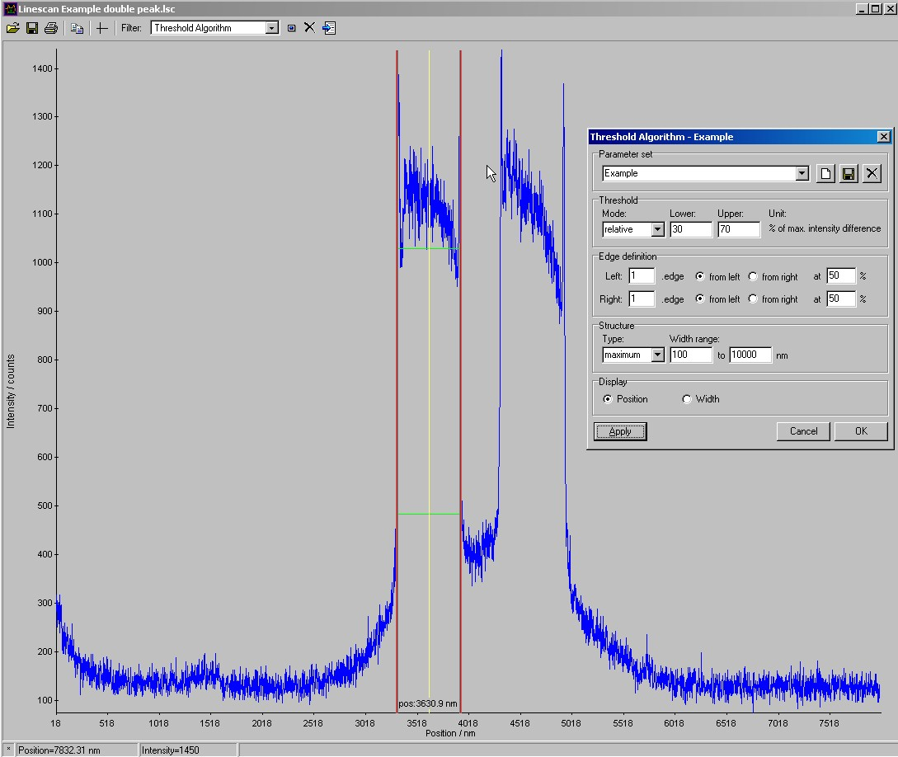
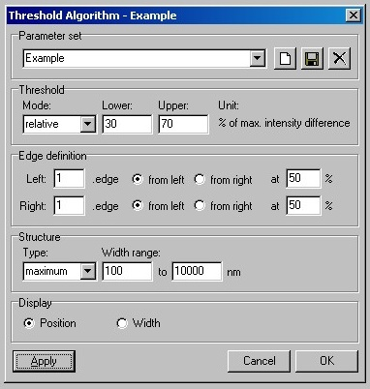
Automatic Mark detection

Slide 75
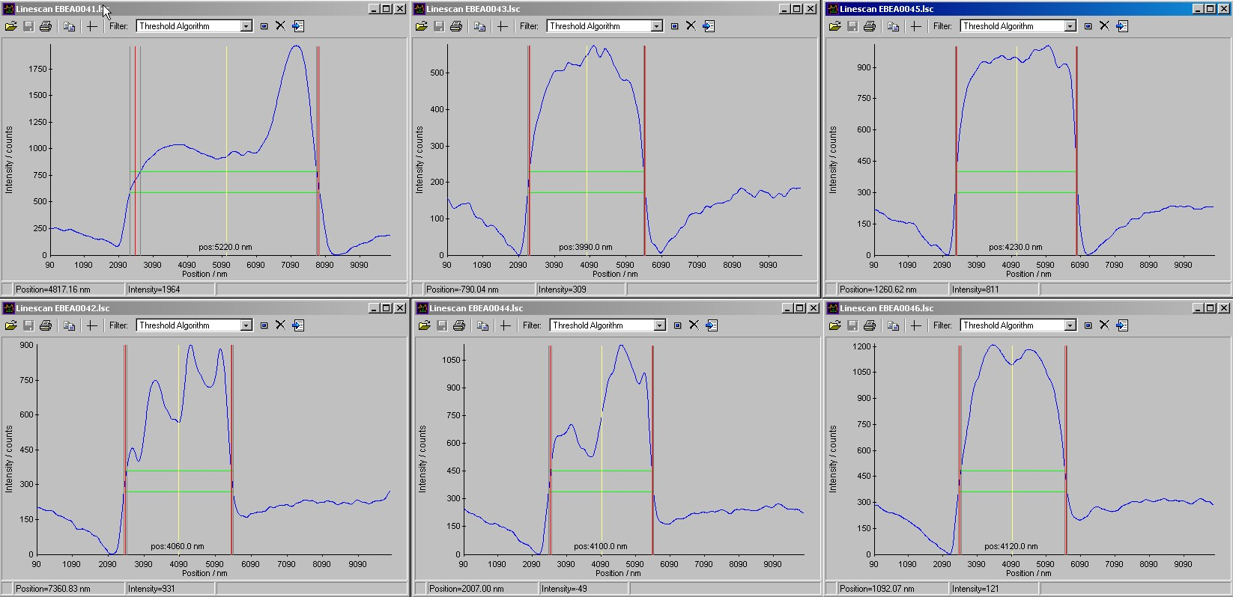
Automatic Mark detection : real sample
1st mark
2nd mark
3rd mark
X
Y

Slide 76
Automatic Mark detection: real sample
Big differences between example and real sample
  Why ?
    Current used
    HV used
    Mark thickness: low thickness # low contrast
    Recessed mark : no chemical contrast
    Mark material
    Resist material : difficult to see marks under HSQ (contain Si)
    Resist thickness: low Z # low emission + absorption of SE
      High resolution implies low thickness
      Low thickness implies low mark thickness:
        If not : non-uniformity & voids after coating
    Detector: BSED more suitable for metals
    Modification of marks during previous steps

Slide 77
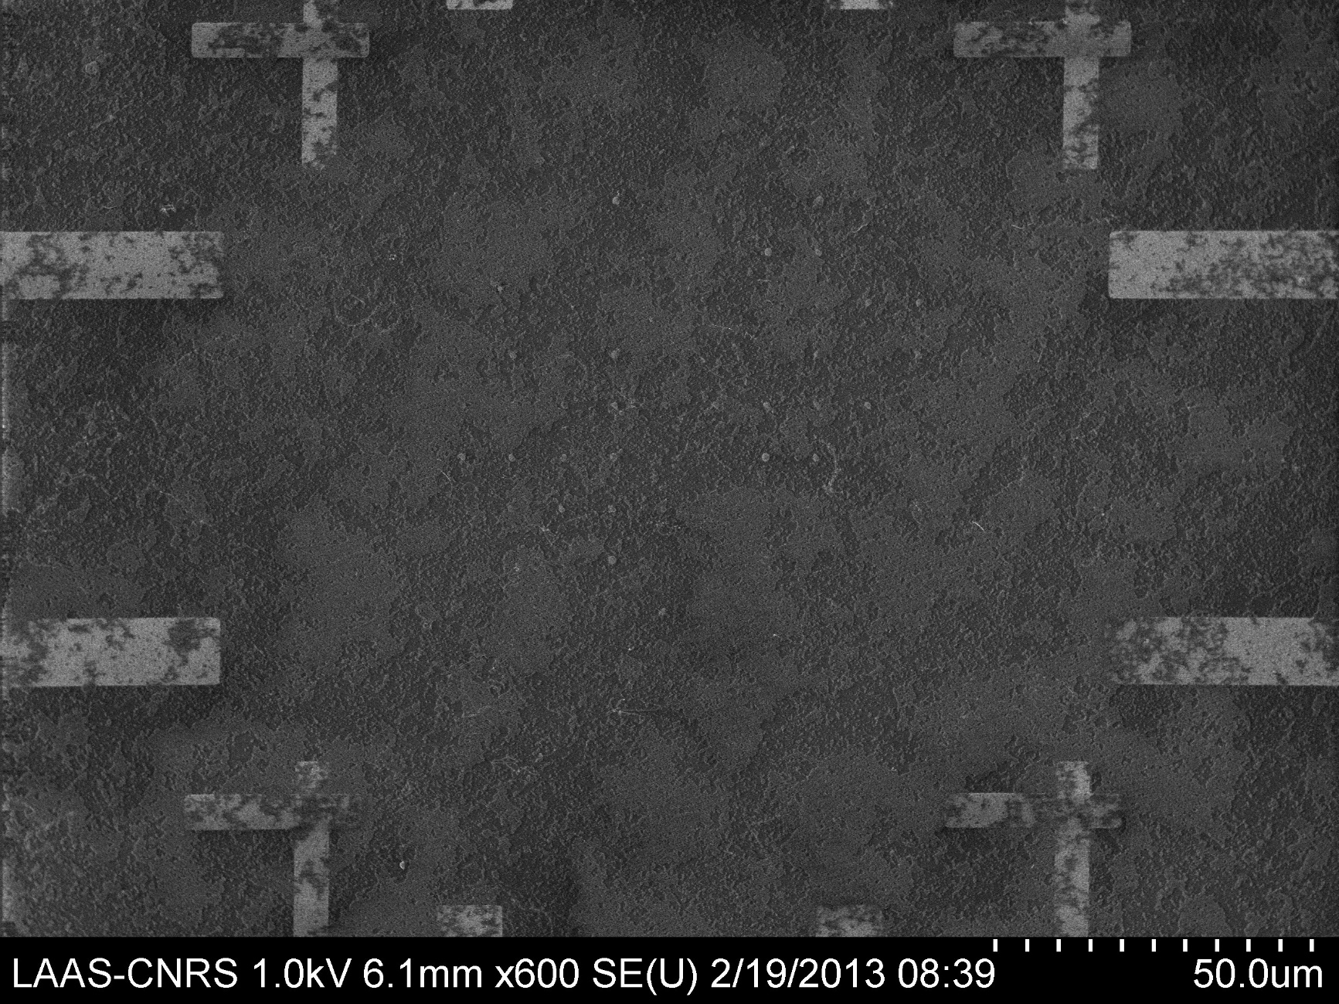
Automatic Mark detection : real sample
After particle deposition,
mark detection signal is no more the same

Slide 78
Automatic Mark detection: real sample
Alignment is reliable if scanning across marks
  Determination of the center
  Center position is independent of previous steps : etching, overexposure, …
  increase averaging zone in case of problem
Alignment using edges is not reliable:
  Edge position depend on previous steps
  Lead always to misalignment
  Useful when:
    there is no other solution
    precision is not required
Alignment precision depend on field-size
  Big field-size # less precision due to linear correction of non-linear distortion
  Limit the field-size

Slide 79
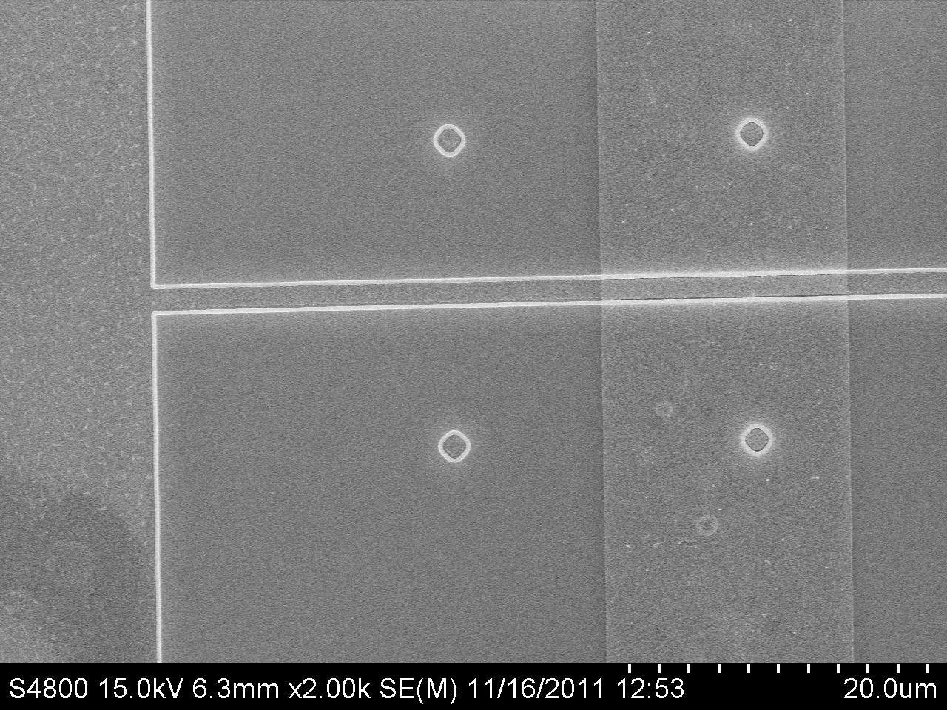
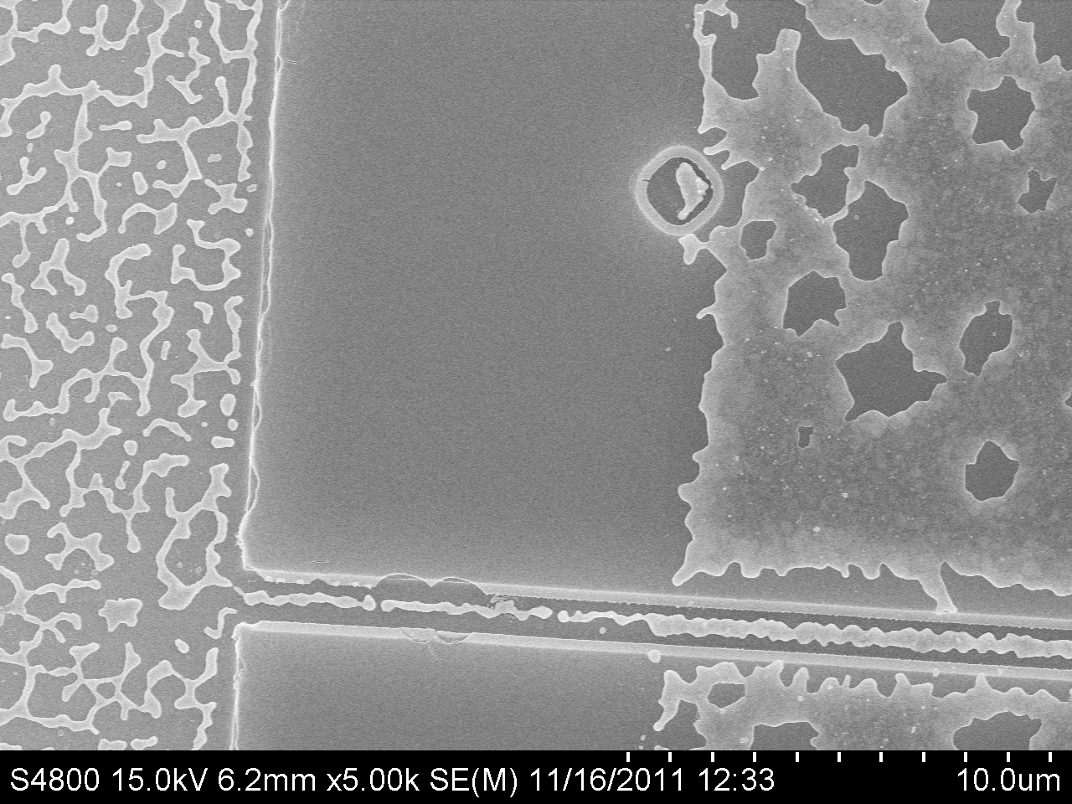
Automatic Mark detection : real sample
Before annealing
After annealing
Mean value of channel position is the same before and after annealing

Slide 80
Introducing myself
Franck CARCENAC
Involved in electron beam lithography and nanofabrication:
  Since 1984
  Lithographies (UV, X-Rays, Electrons), lift-off, wet/dry etching, characterization
  Si and III-V compounds
  Nanoelectronics, optics, nanomagnetism, nanobiotechnologies among others
  Adaptation, testing/purchasing procedures, installation:
    30keV SEM
    30 - 50keV E-Beam writer (soon 100keV)
    200keV TEM/STEM
People training on SEM, EBL, nanofabrication:
  France and international

Slide 81
Bibliography
Best jams are made in old jars … today's physics is based on the sum of all previous discoveries
P. Rai-Choudhury (Ed.) : Handbook of Microlithography,
http://en.wikipedia.org/wiki/Electron_beam_lithography
SPIE Handbook of Microlithography, Micromachining and Microfabrication
Nanotechnology, special number of “Microelectronic Engineering”. Vol. 32, September, 1996.
Nanometer-Scale Science & Technology, special number of “Proceedings of the IEEE”. Vol 85, April 1996.
N. Taniguchi (Ed.) Nanotechnology : Integrated Processing Systems for Ultra-precision and Ultra-fine Products, Oxford - University Press, 1997.
Philip Ball, Made to Measure, Princeton University Press - 1994.
H.C.Hoch et al (Eds.), Nanofabrication and Biosystems - Cambridge University Press, 1996.
Semiconductor Industrial Association, The National Technology Roadmap for Semiconductors,1997.
Fundamentals of microfabrication – Marc Madou - CRC Press, (1997)

Slide 82
Exposure
Electrons from the beam:
  Exposure at beam impact position
  Forward scattering: enlargement of the beam inside the resist
Backscattered electrons:
  Belong to primary beam: energy >50eV
  Escape mainly from substrate through the electrosensitive material
  Enlargement from beam impact position to a distance proportional to energy (~1µm/10keV)
  Trajectory simulation: CASINO free software from Sherbrooke university - CANADA
  ~20% of primary electrons on Si @ 30keV (30% on GaAs, 50% on gold)
Secondary electrons:
  Produced by interaction of high energy electrons with matter: energy <50eV
  Close to scattered electrons trajectory (~10nm)
  ~80% of electrons involved in exposure (on Si)  main contribution to proximity effects

